Slide 1

INFORMATION SYSTEM
UNIT 02 : TYPES OF INFORMATION SYSTEM
© 2018, PRAMOD PARAJULI

Slide 2
Disclaimer
These slides are part of teaching materials for Information System (IS). These slides do not cover all aspect of learning IS, nor are these to be taken as primary source of information. As the core textbooks and reference books for learning the subject has already been specified and provided to the students, students are encouraged to learn from the original sources.
Contents in these slides are copyrighted to the instructor and authors of original texts where applicable.

Slide 3
TYPES OF INFORMATION SYSTEMS
2.1. Classification of IS – by support function, by organizational level
2.2. Organizational Level Classification – Strategic Level, Management Level, Knowledge Level, Operational Level
2.3 Support Function Classification – functional (departmental), enterprise wide, inter-organizational systems
2.4 Transaction Processing Systems, Enterprise Management Systems - ERP/SCM/CRM, Decision support and intelligent systems, Expert systems

Slide 4
2. Types of Information System
Referneces - - - - - - - - Laudon and Laudon, Management Information Systems – Managing the Digital Firm, 13th Edition, Pearson

Slide 5
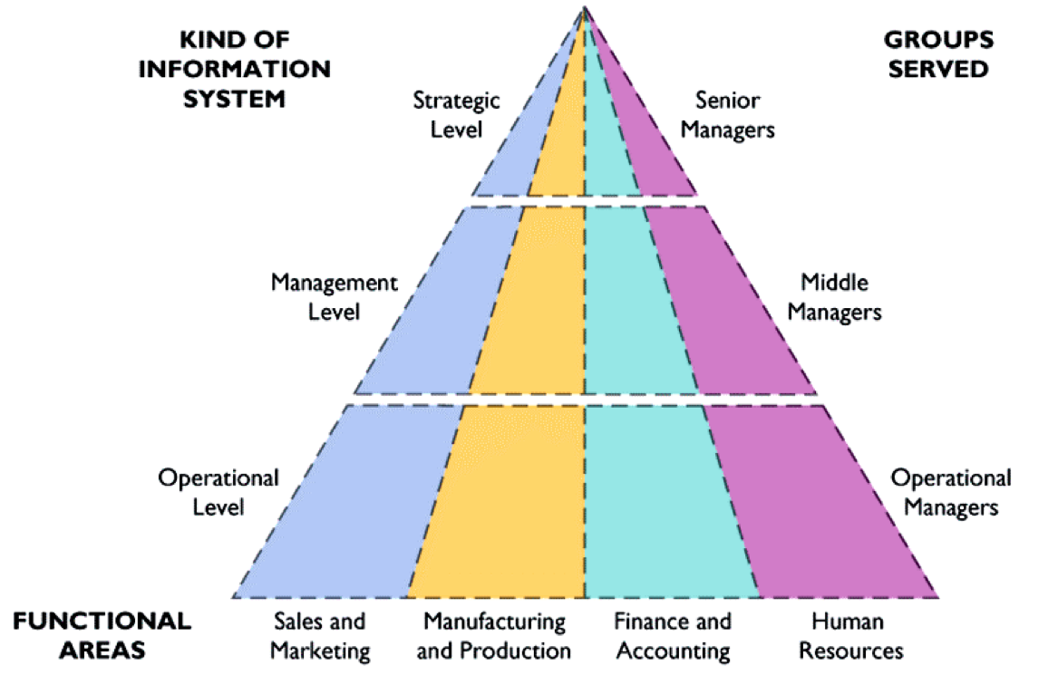
Major types of systems in organizations Functional areas of IS

Slide 6
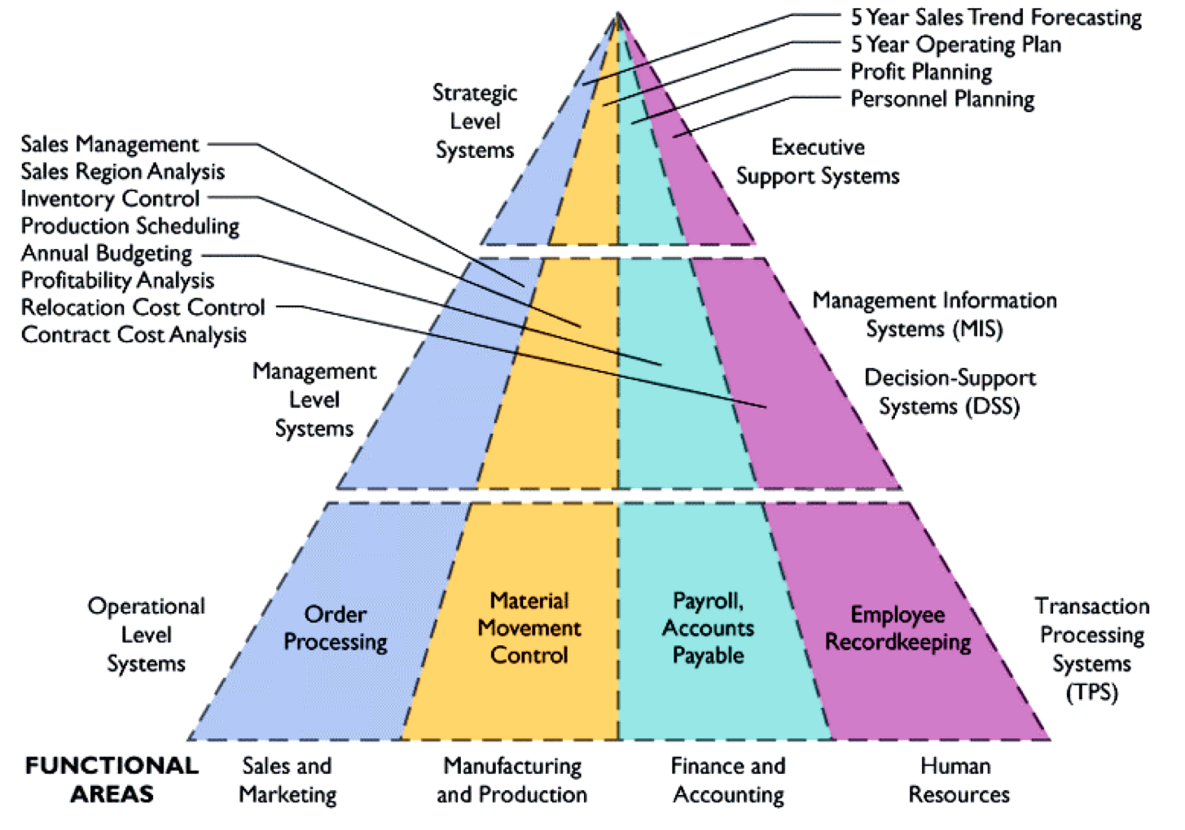
Major types of systems in organizations TPS, MIS, DSS, ESS

Slide 7
case – Vitamin A project
Strategic
Tactical
Operational

Slide 8
Transaction processing systems
Basic business systems that serve the organization’s operational level
Input: Transactions, events
Processing: Sorting, listing, merging, updating
Output: Detailed reports, lists, summaries
Users: Operations personnel, supervisors

Slide 9
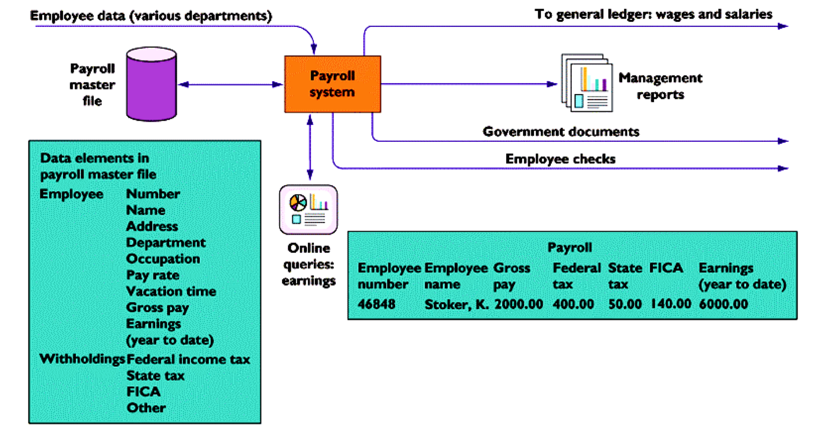
Transaction processing systems Example – Payroll TPS

Slide 10
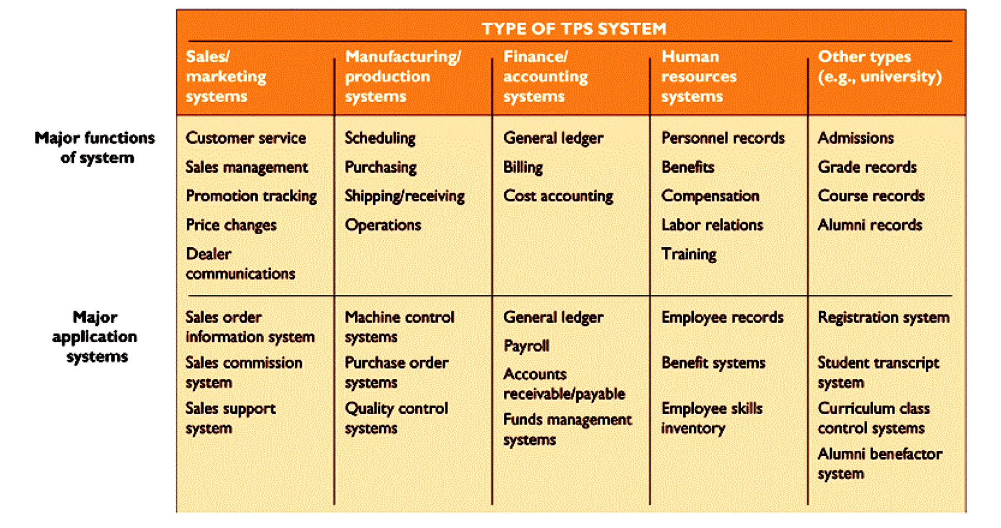
Transaction processing systems Typical applications

Slide 11
Management Information System
Serve management level; provide reports and access to company data
Input: Summary transaction data, high-volume data, simple models
Processing: Routine reports, simple models, low-level analysis
Output: Summary and exception reports
Users: Middle managers

Slide 12
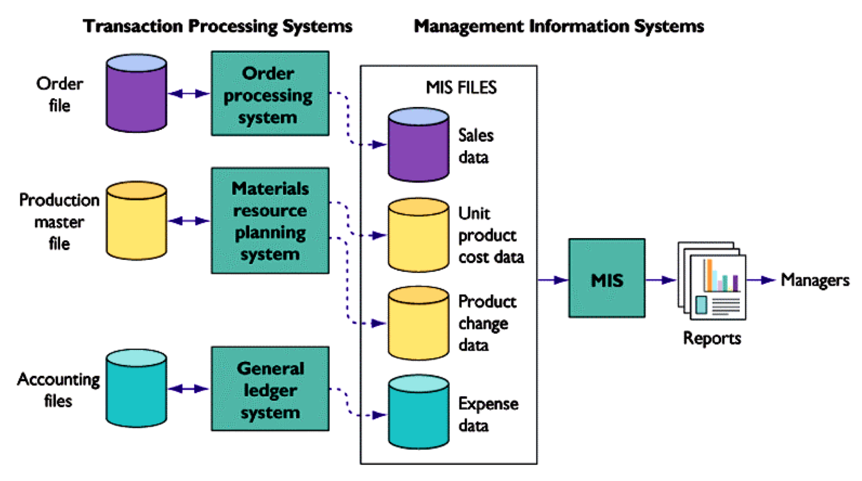
TPS and MIS Interaction

Slide 13
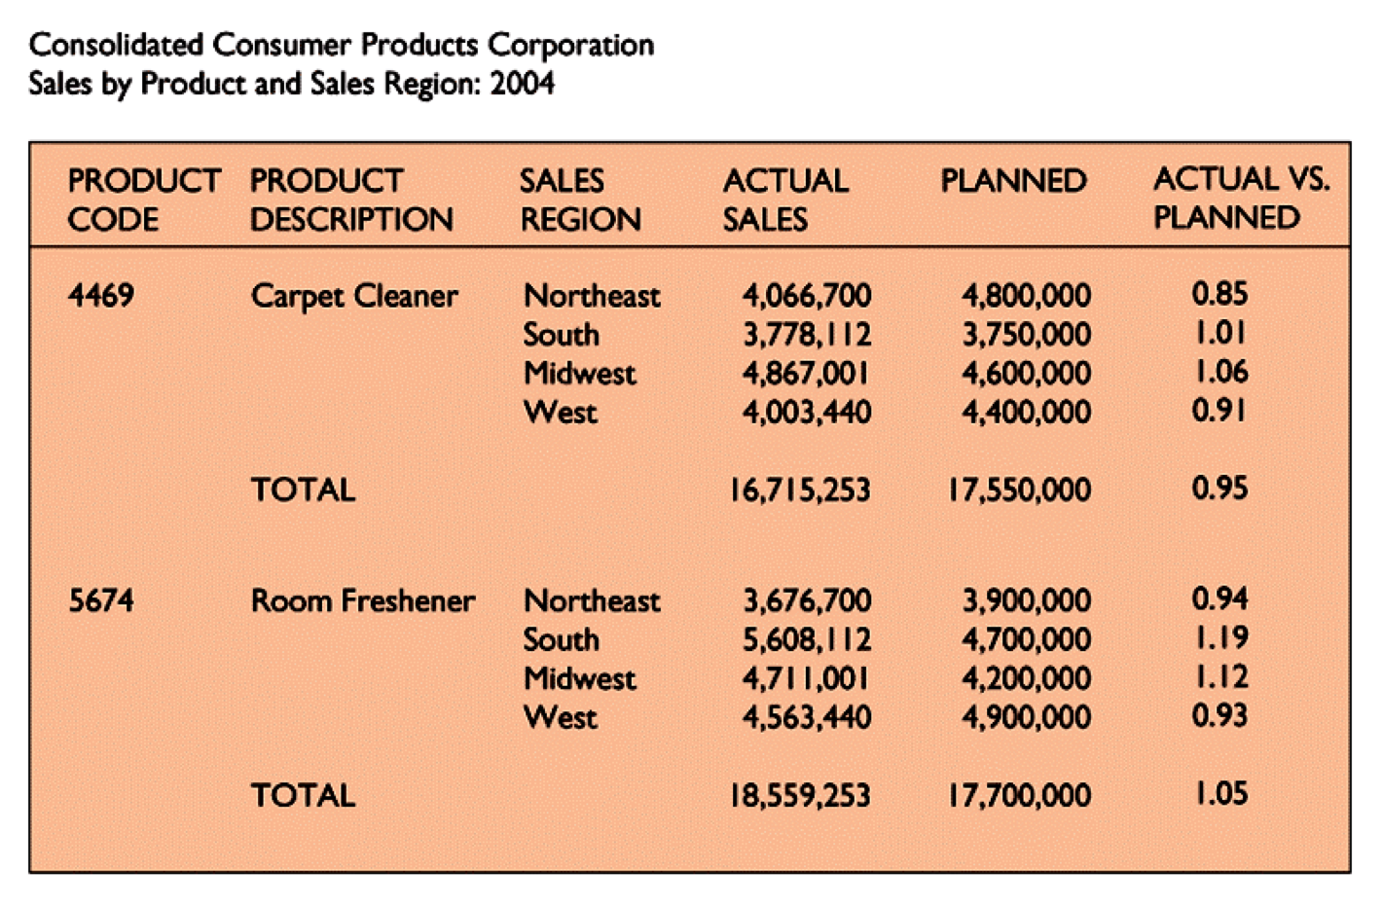
MIS sample report

Slide 14
Decision support systems
Serve management level with data analysis for making decisions
Input: Low-volume data or massive databases, analytic models, and data analysis tools
Processing: Interactive, simulations, analysis
Output: Special reports, decision analyses, responses to queries
Users: Professionals, staff managers

Slide 15
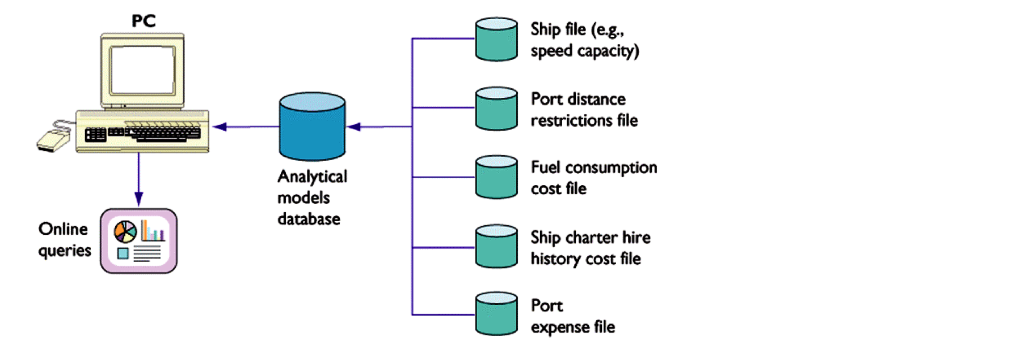
Voyage estimating DSS

Slide 16
Executive support systems (ESS)
Provide communications and computing environment that serves the organization’s strategic level
Input: External and internal aggregate data
Processing: Graphics, simulations, interactive
Output: Projections, responses to queries
Users: Senior Managers

Slide 17
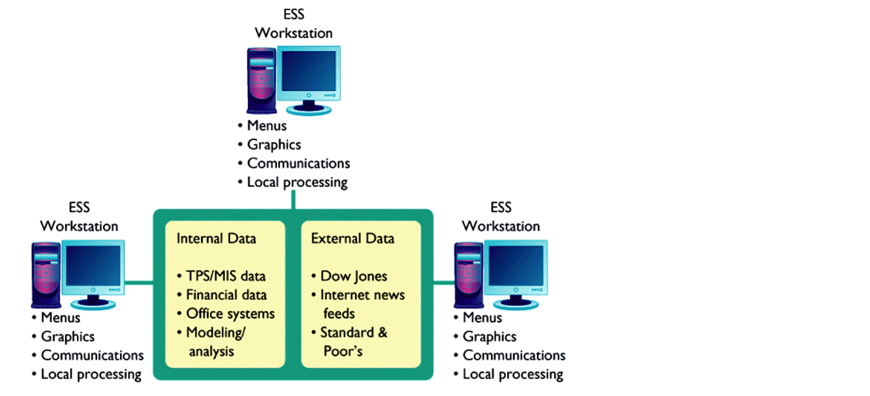
Executive support systems (ESS)

Slide 18
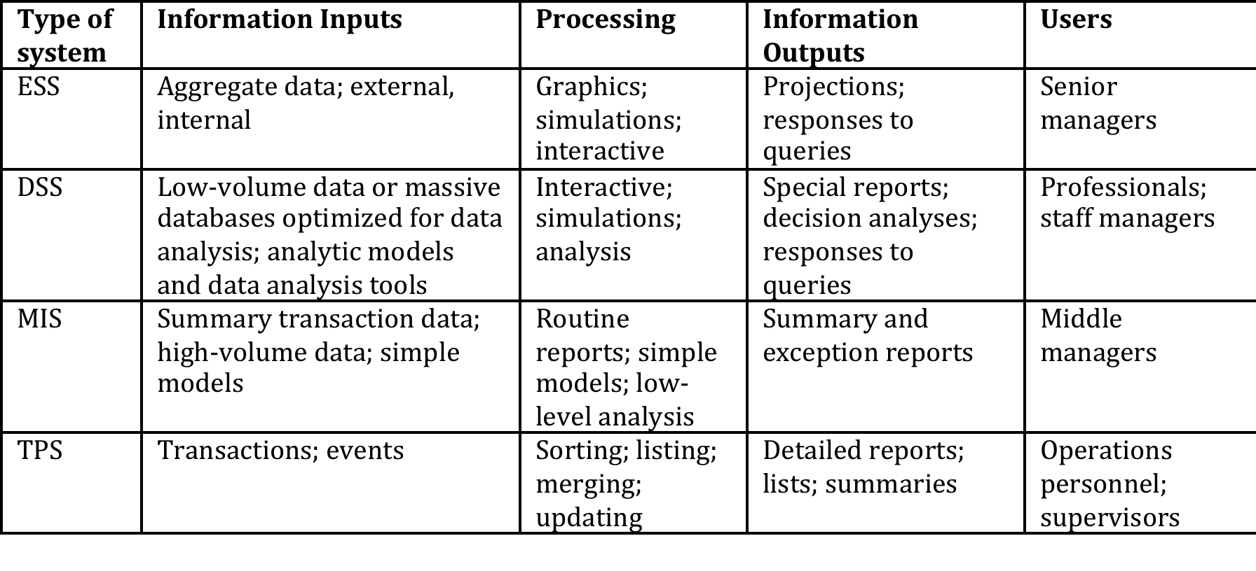
Summary of ISs

Slide 19
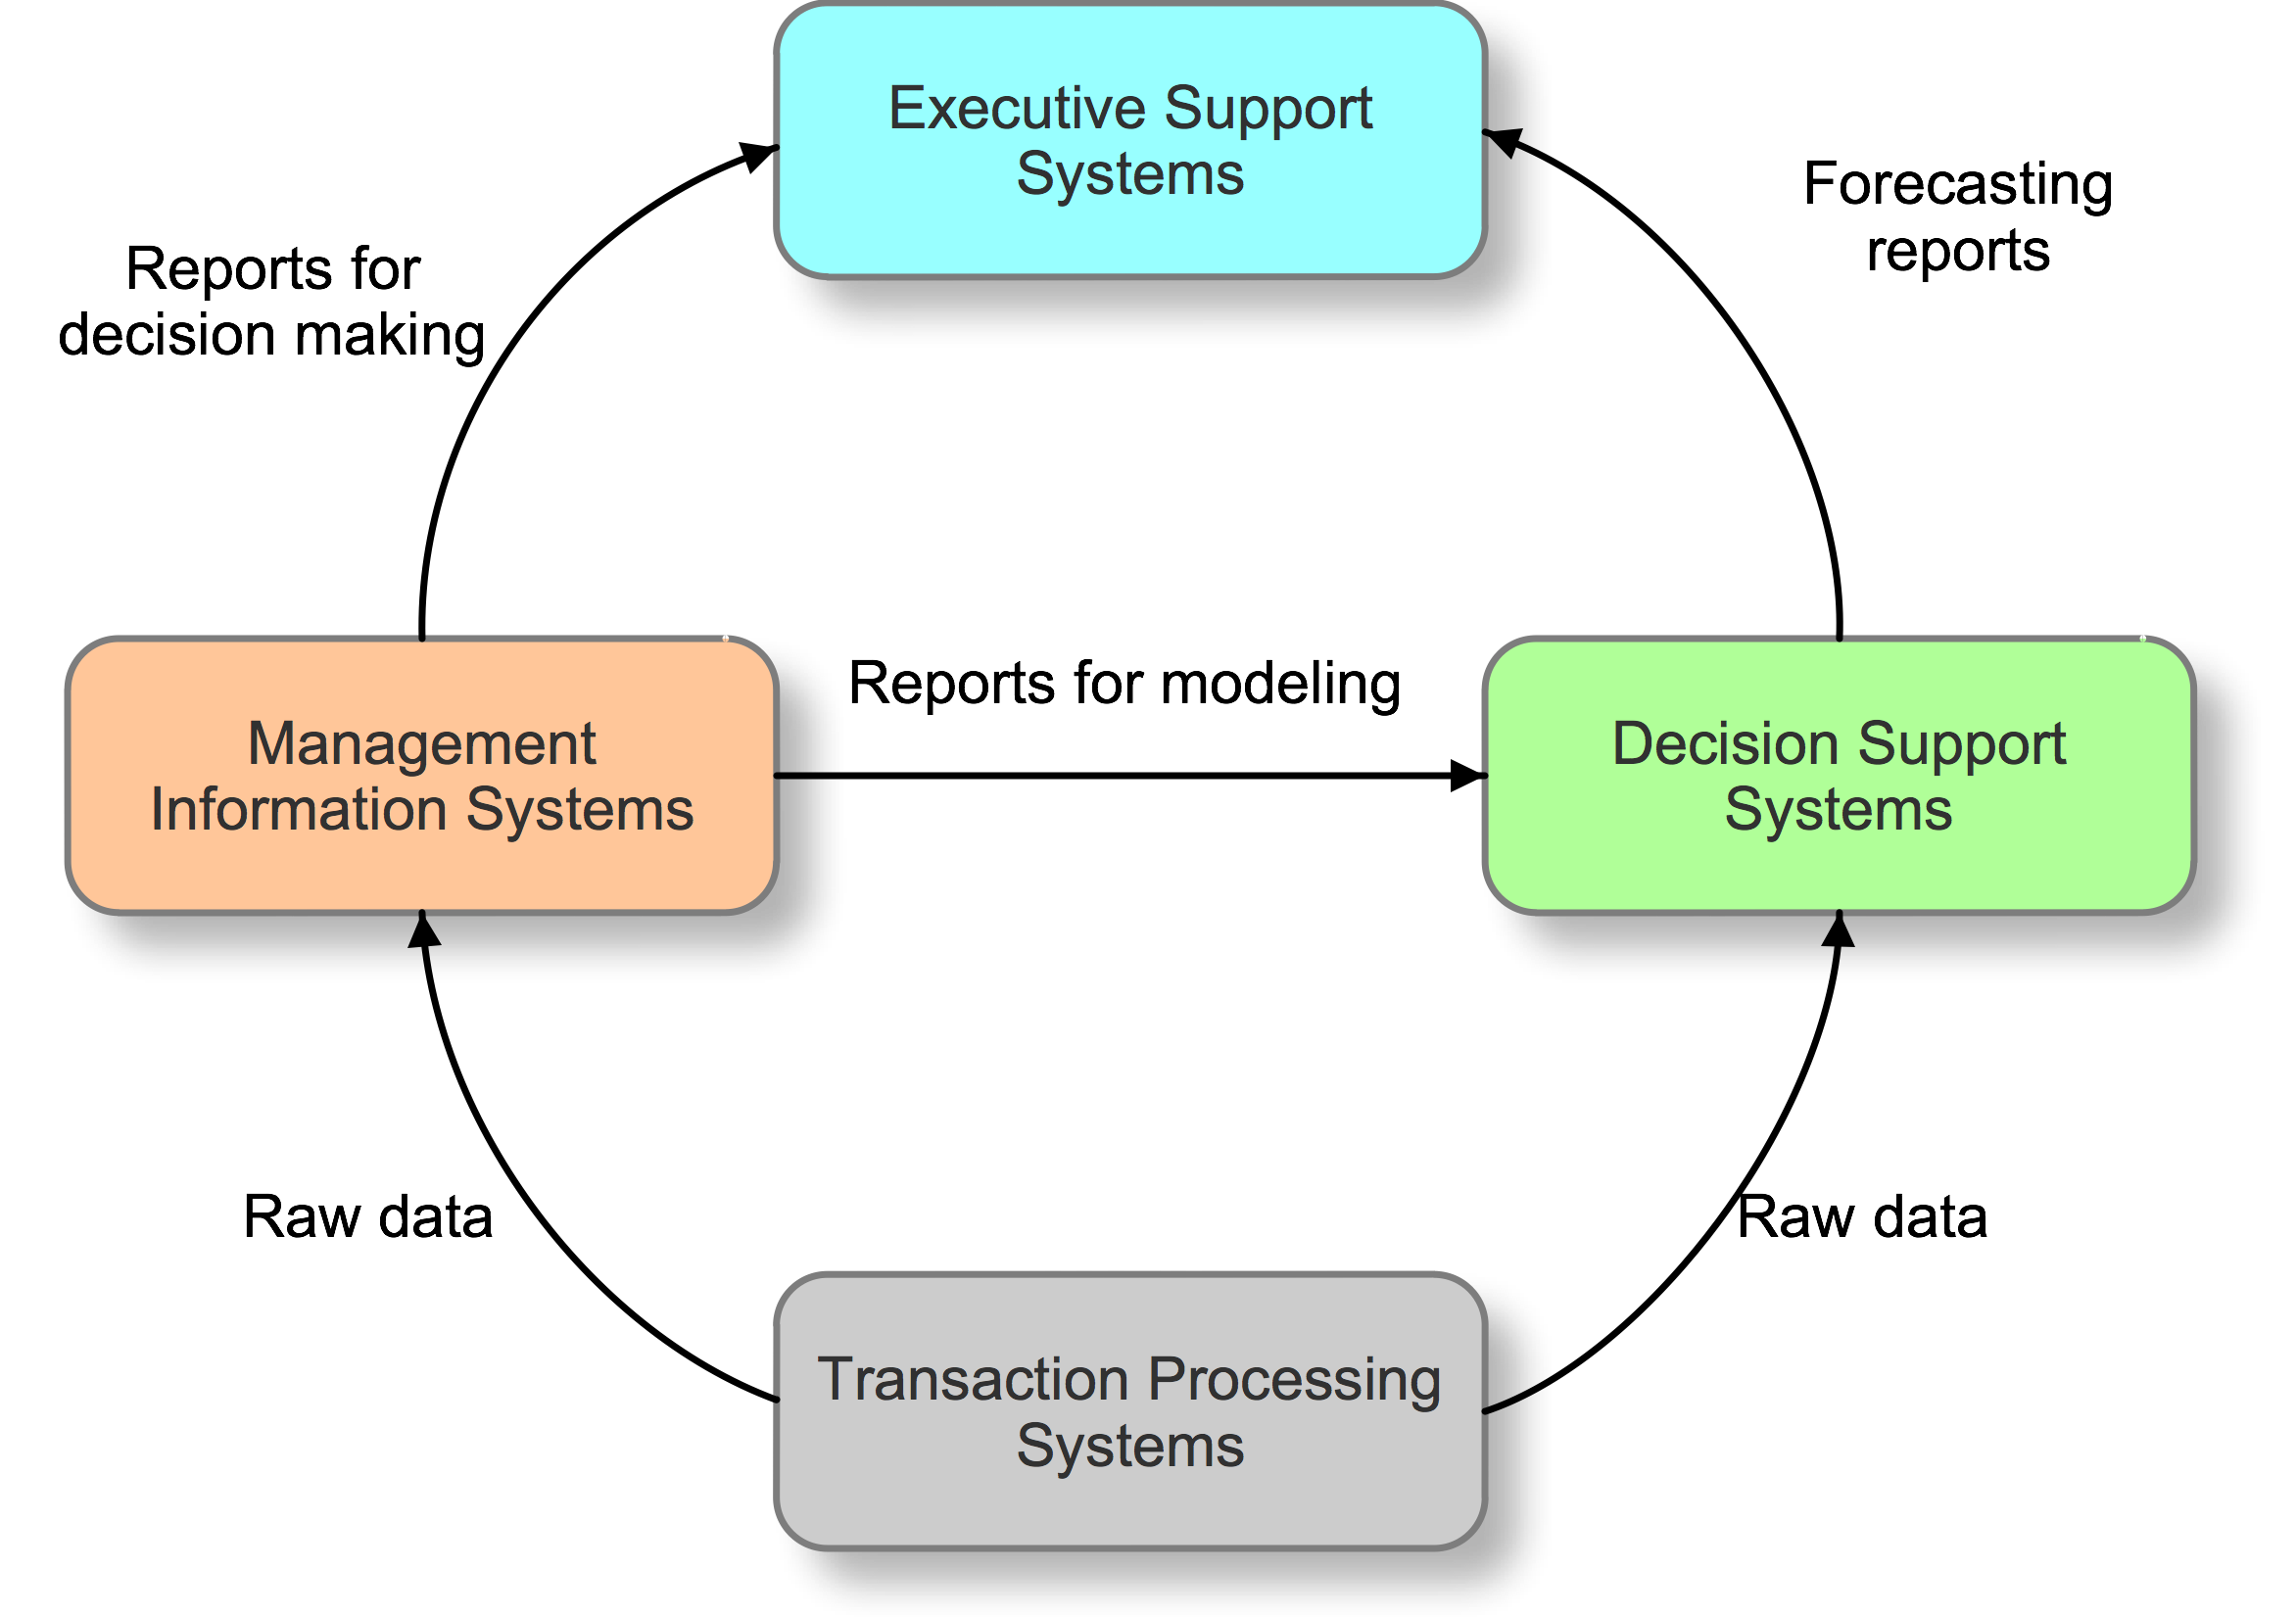
Interconnection among ISs

Slide 20
SYSTEMS FROM Functional PERSPECTIVE
Office automation systems
Sales and marketing information systems
Manufacturing and production systems
Accounting and financial management systems
Human resource management systems

Slide 21
Office automation systems
Automation in office works is called office automation (OA).
OA includes the new hardware, software technologies – word processors, spreadsheet packages, e-mail and so on that make office workers more productive.
These technologies that change the productivity of employees are called office information systems (OIS).

Slide 22
Office work
Various tasks are performed in the office
Decision-making
Data manipulation
Document handling
Communication
Storage

Slide 23
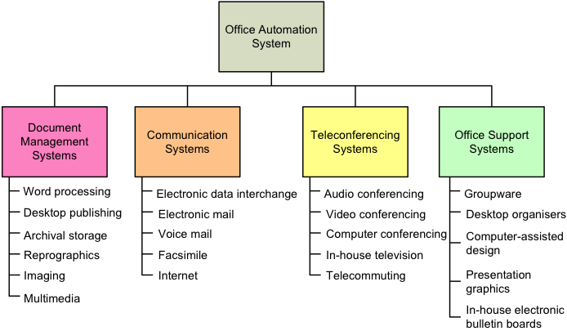
Types of office automation systems

Slide 24
Evolution of Office Systems
Until the mid 1960s, typewriters, phones, copying machines, electronic adding machines etc. were used to automate office works.
Then from 1964, work processing appeared.
In 1970s large corporations started using distributed data processing (DDP) by decentralizing the data storage and processing capabilities.
Due to the availability of inexpensive microcomputer systems, quality microcomputer software, e-mail, Internet, LAN, and gateways to powerful computing facilities, the office technology is changing yet again.

Slide 25
Evolution of Office Systems
These days, the primary purpose of office information system is to facilitate communication among members of an organization and between the organization and its external environment.
It allows individuals and group members to create, store, and exchange messages through a variety of communications media, including data, documents, images, voice (audio), and video.
OA is moving towards realization of implementing an electronic office and virtual corporation.

Slide 26
Virtual Corporation
It gives people the ability to work from any place without being confined by physical boundaries.
Employees use technology to come together temporarily and communicate to achieve a shared business goal.
Businesses need not invest in office space, furniture, and other amenities.
Mobile computing allows workers at remote locations to dial up the office, receive messages and urgent documents, and give directions to their co-workers.
Managers decide when shall a face-to-face meeting be conducted.

Slide 27
Virtual Corporation - challenges
Managers loose direct control over employees
Employees may not be able to meet the around-the-clock deadlines
Might lead to employee burnout
Use of technology and decisions affects the productivity of employees
Case: Marissa Mayer and Yahoo Inc!

Slide 28
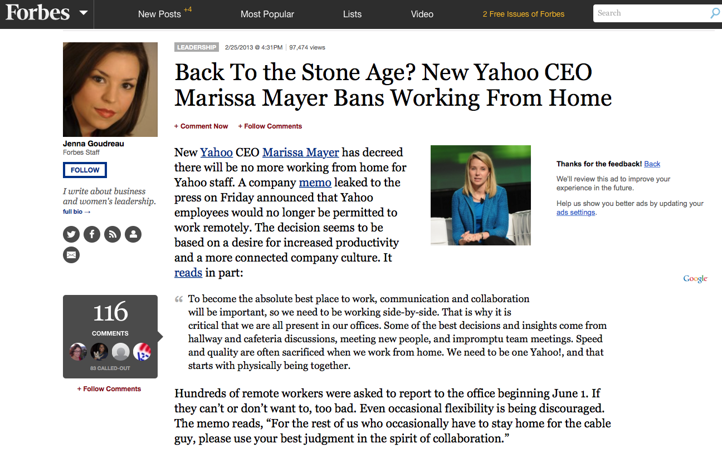

Slide 29
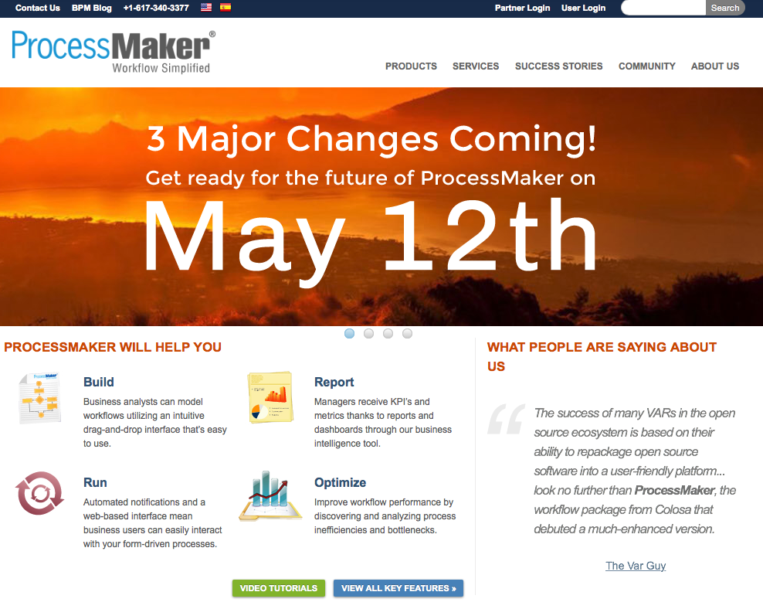

Slide 30
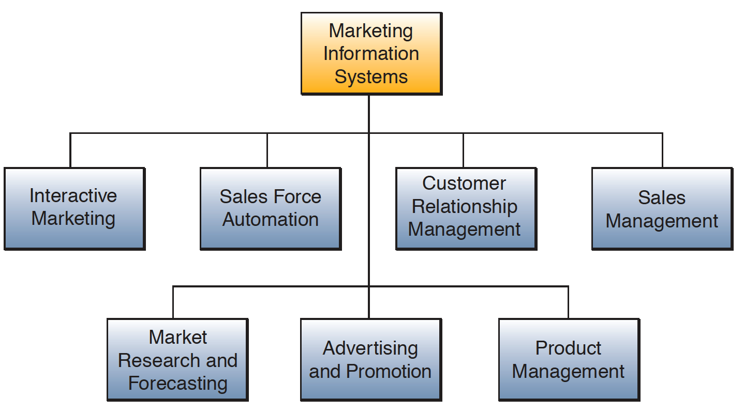
SALES AND Marketing systems
Notes:
Examples of each:
Interactive marketing – capturing user behavior to customise the marketing contents e.g. cookies, targeted marketing
Sales force automation – automate flow of information required for sales crew
CRM – taking customer feedback and responding in organised manner e.g. ticketing system
Sales management – inventory management
Market research and forecasting – survey and predictions, use quantitative methods, latest trend – business analytics
Advertising and promotion – media design and development, dissemination
Product management – customised products

Slide 31
Marketing systems
Interactive marketing – capturing user behavior to customise the marketing contents e.g. cookies, targeted marketing
Sales force automation – automate flow of information required for sales crew
CRM – taking customer feedback and responding in organised manner e.g. ticketing system
Sales management – inventory management
Market research and forecasting – survey and predictions, use quantitative methods, latest trend – business analytics
Advertising and promotion – media design and development, dissemination
Product management – customised products

Slide 32
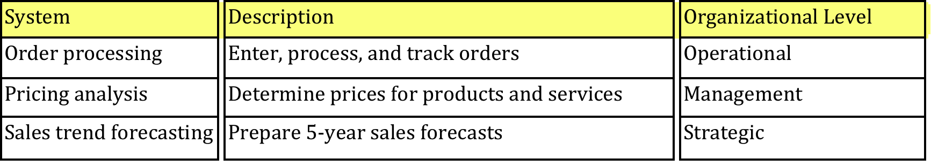
Sales and marketing systems
Help identify customers
Develop products and services
Promote products and services
Sell products and services
Provide ongoing customer support

Slide 33
Sales and marketing systems
Tools
Point-of-Sale (computer, POS software, barcode scanner, RFID scanner, cash counter etc.)
Sales force automation
e-Commerce transactions
Marketing channels (newsletter, email, web-form feedback, SMS marketing etc.)
Marketing research tools (Business Intelligence)

Slide 34
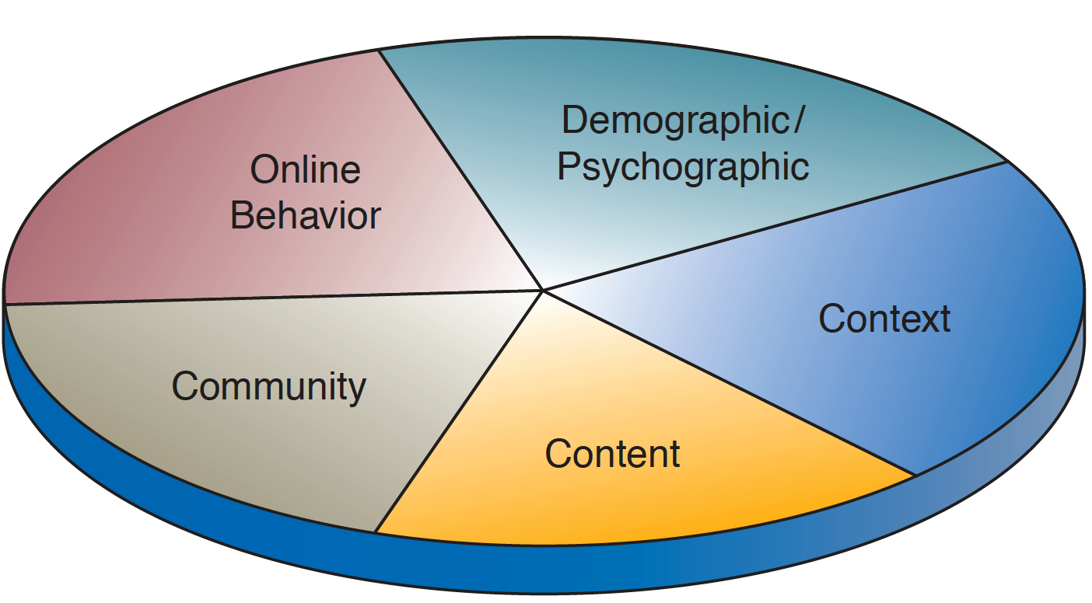
Targeted marketing - components

Slide 35
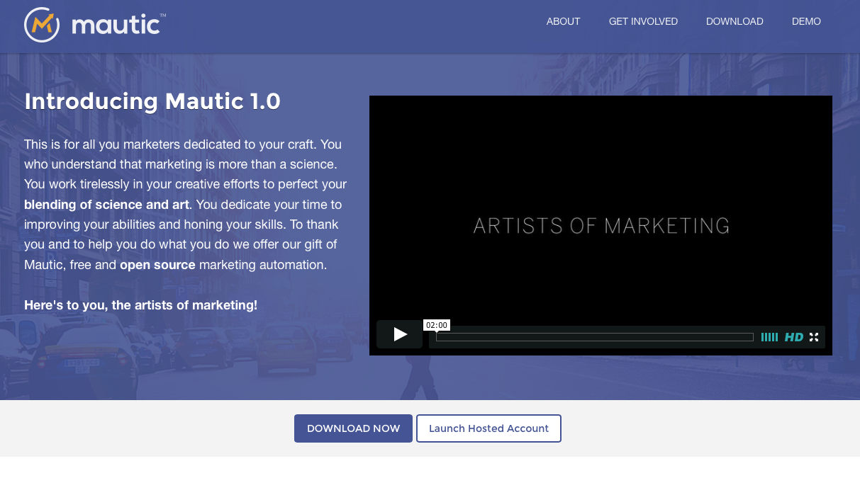

Slide 36
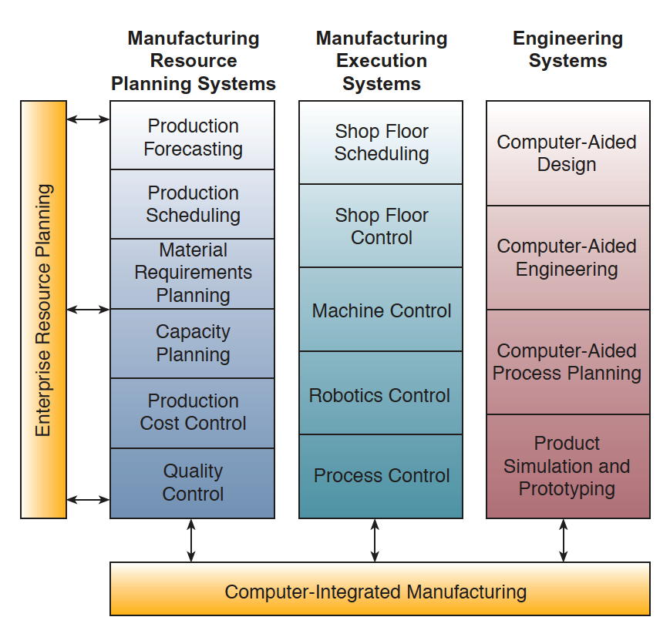
Manufacturing AND PRODUCTION systems

Slide 37
Manufacturing and production systems
Planning, development, production of products and services
Planning, development, maintenance of production facilities
Acquisition, storage, availability of materials
Scheduling materials, facilities, labor
Controlling the flow of production

Slide 38
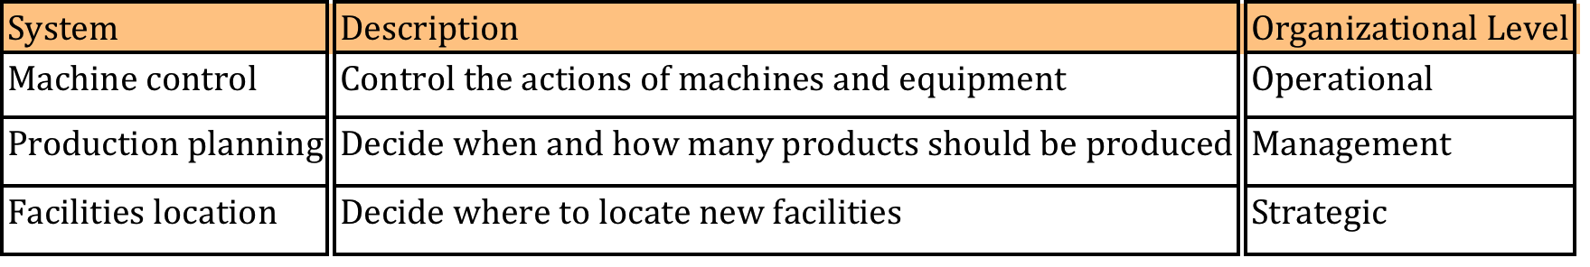
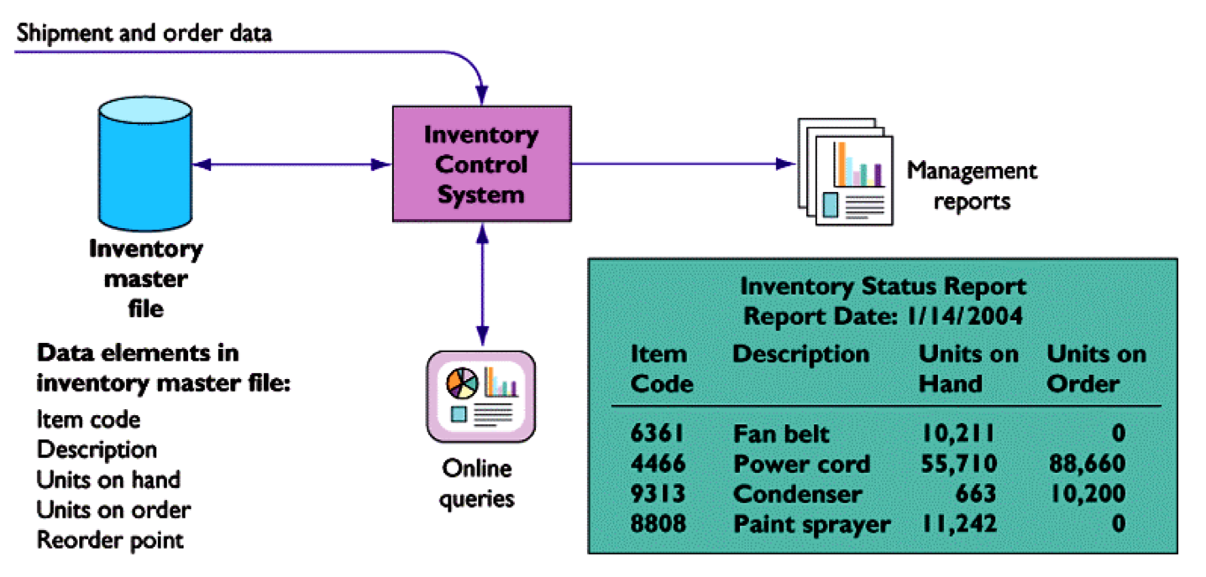
Manufacturing and production systems

Slide 39
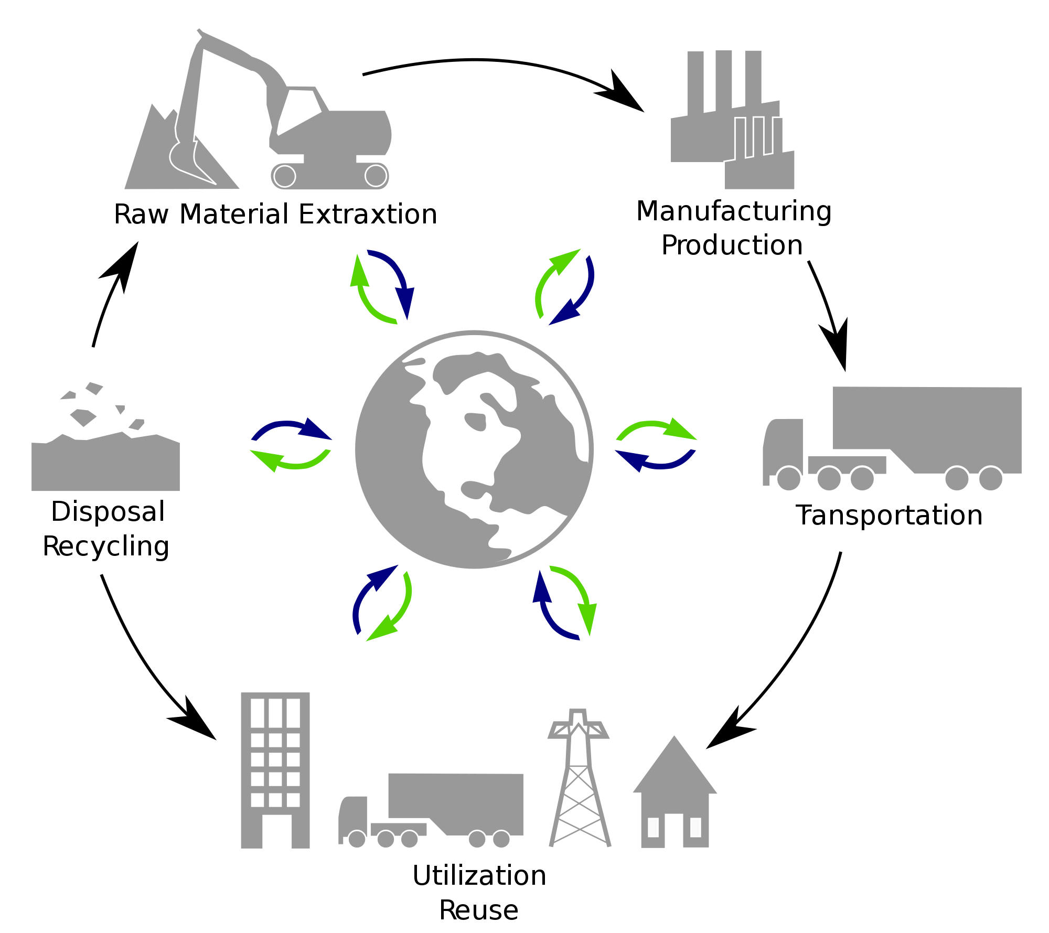
Manufacturing systems - tools
Product lifecycle management (PLM systems)
Production line control system
Material movement control
Staff assignment systems
Sensor networks
Inventory management systems

Slide 40
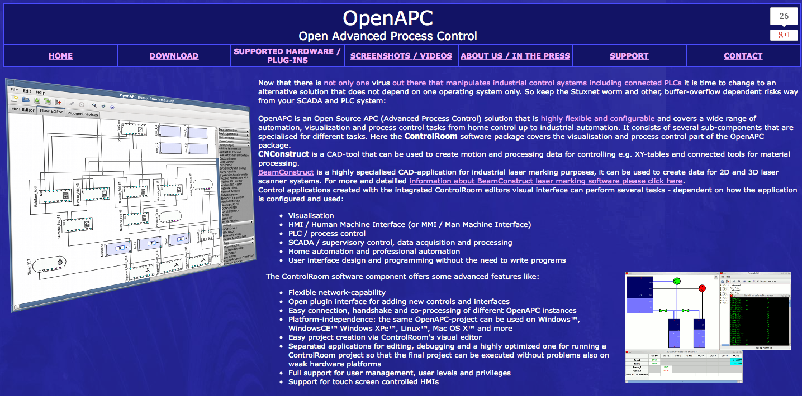
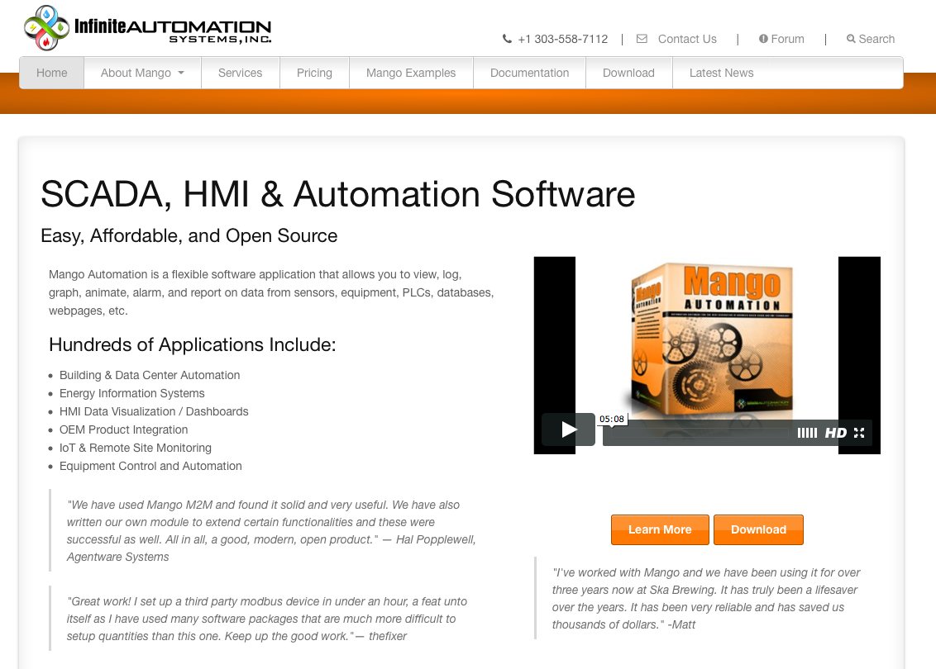

Slide 41
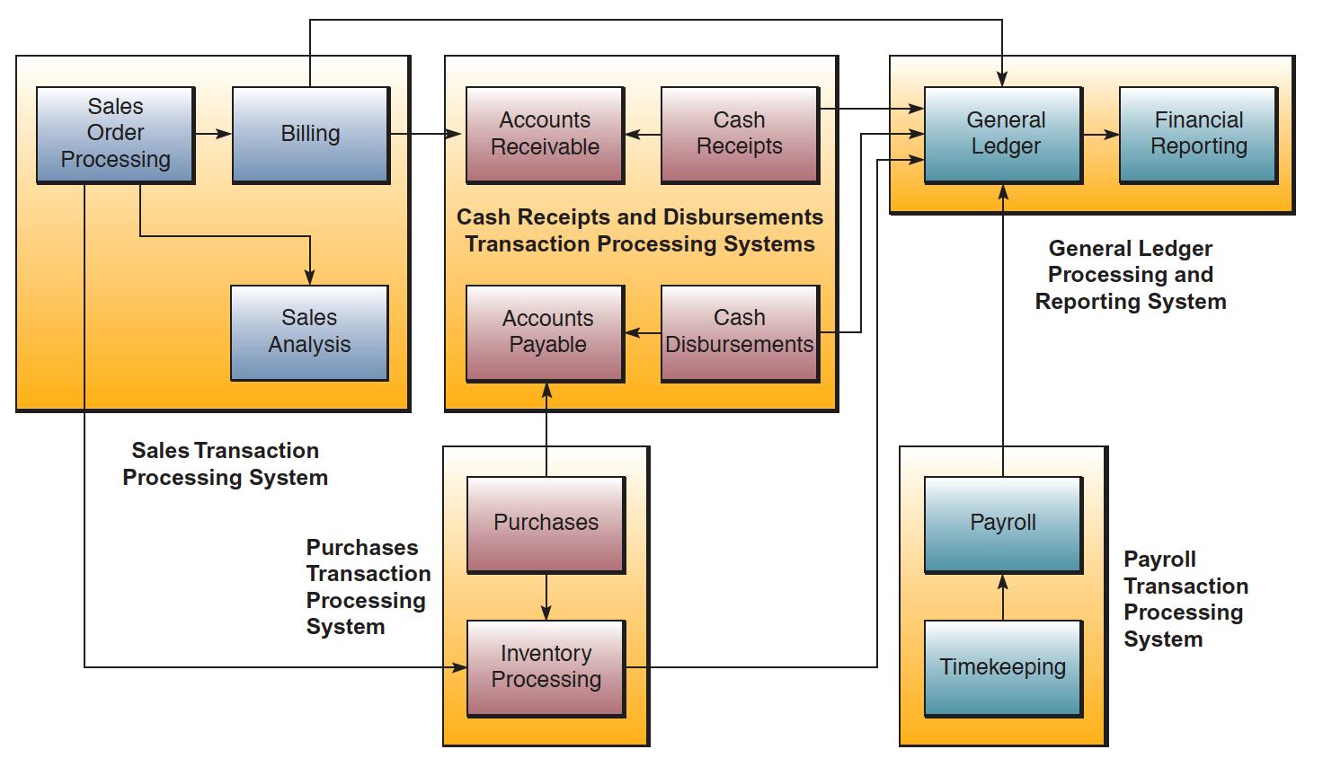
Finance and Accounting systems

Slide 42
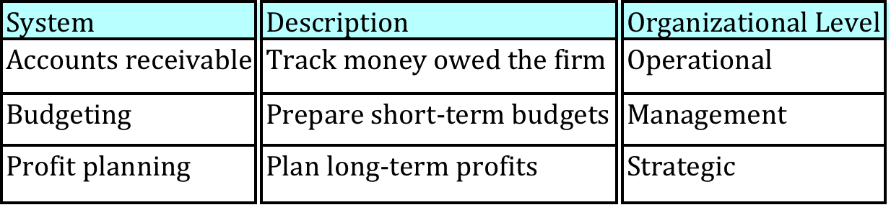
Finance and accounting systems
Manage firm’s financial assets: cash, stocks, bonds, etc.
Manage capitalization of firm and finding new financial assets
Maintain and manage financial records

Slide 43
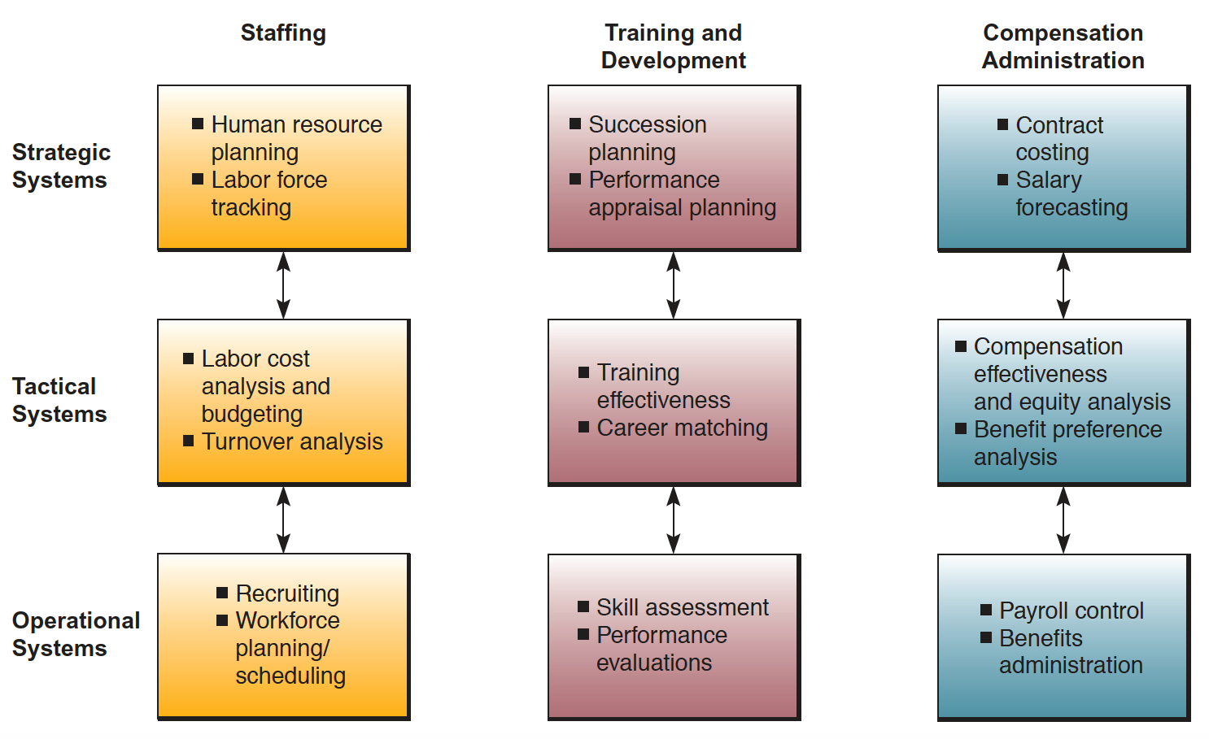
Human resource MANAGEMENT systems

Slide 44
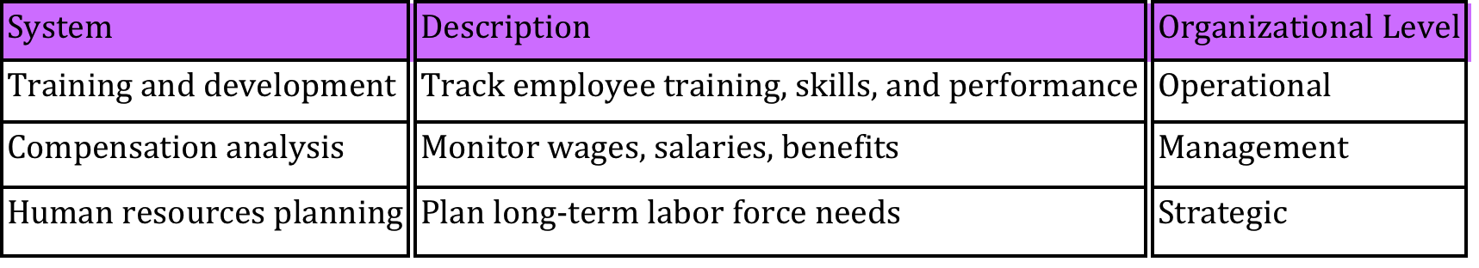
Human resource MANAGEMENT systems
Identify potential employees
Maintain employee records
Track employee skills, job performance, and training
Support planning for employee compensation and career development

Slide 45
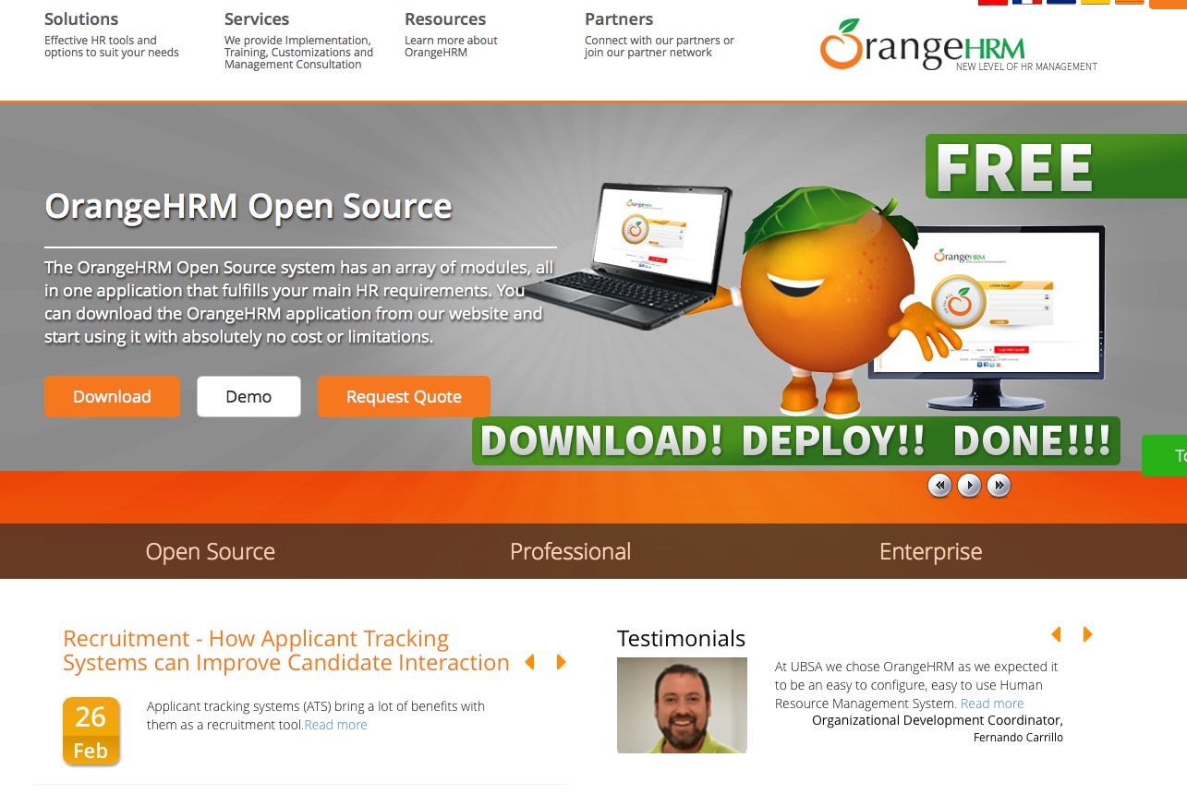

Slide 46
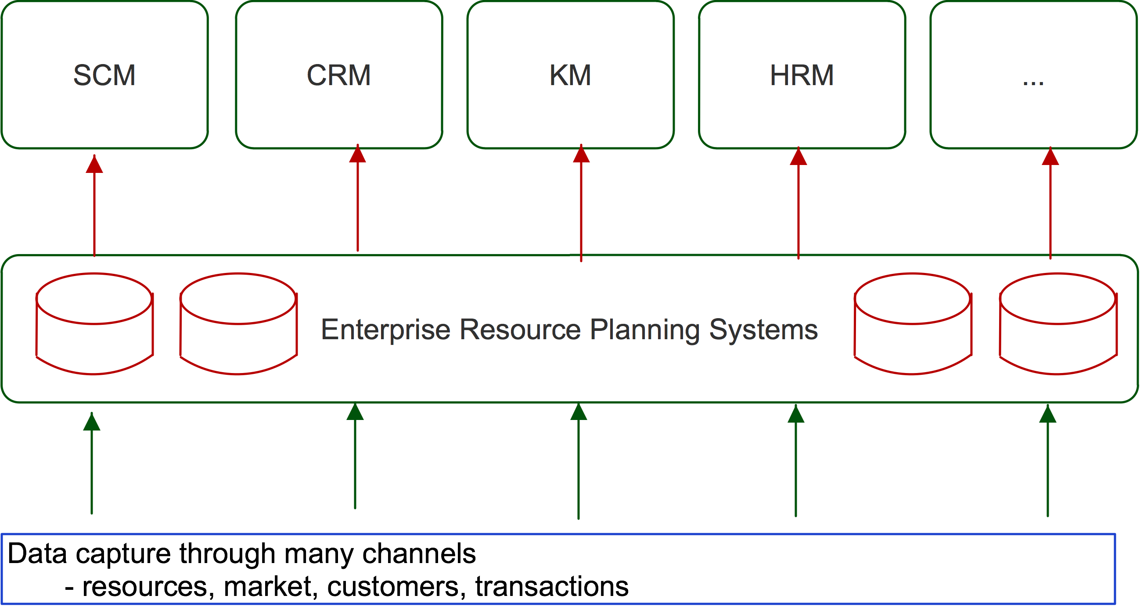
Business software

Slide 47
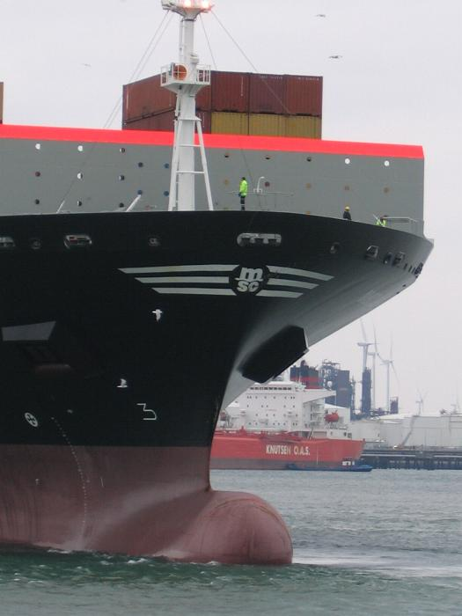
Case: Mediterranean shipping company
Business goal: cost leader, growth, transparency
Problem: Invisibility, port taxes
Solution: SCM Systems
Benefits:
Reduced costs
Visibility

Slide 48
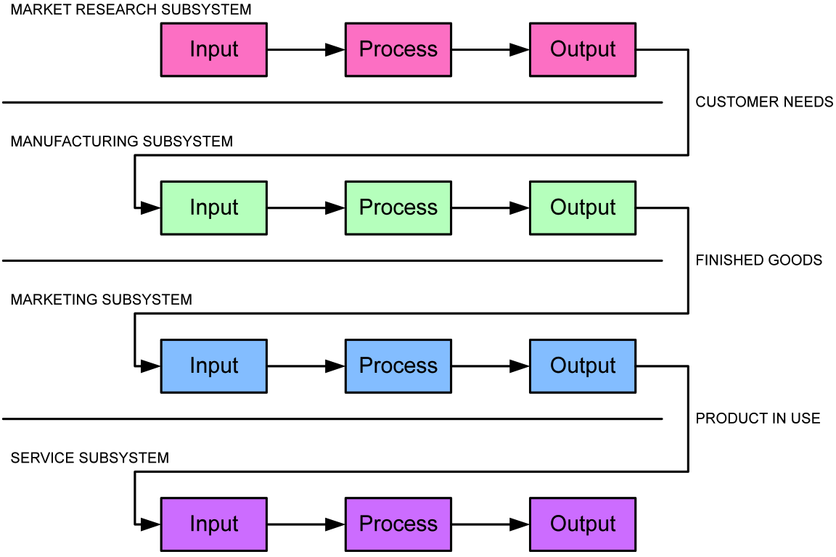
Cross functional systems

Slide 49
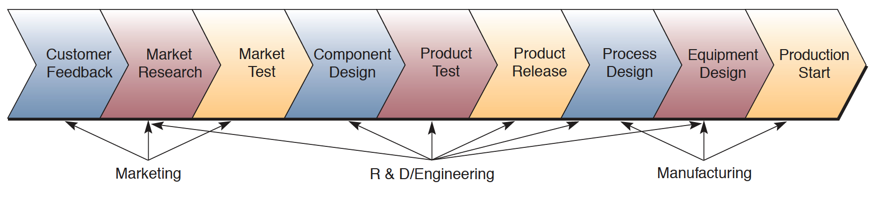
Cross functional systems

Slide 50
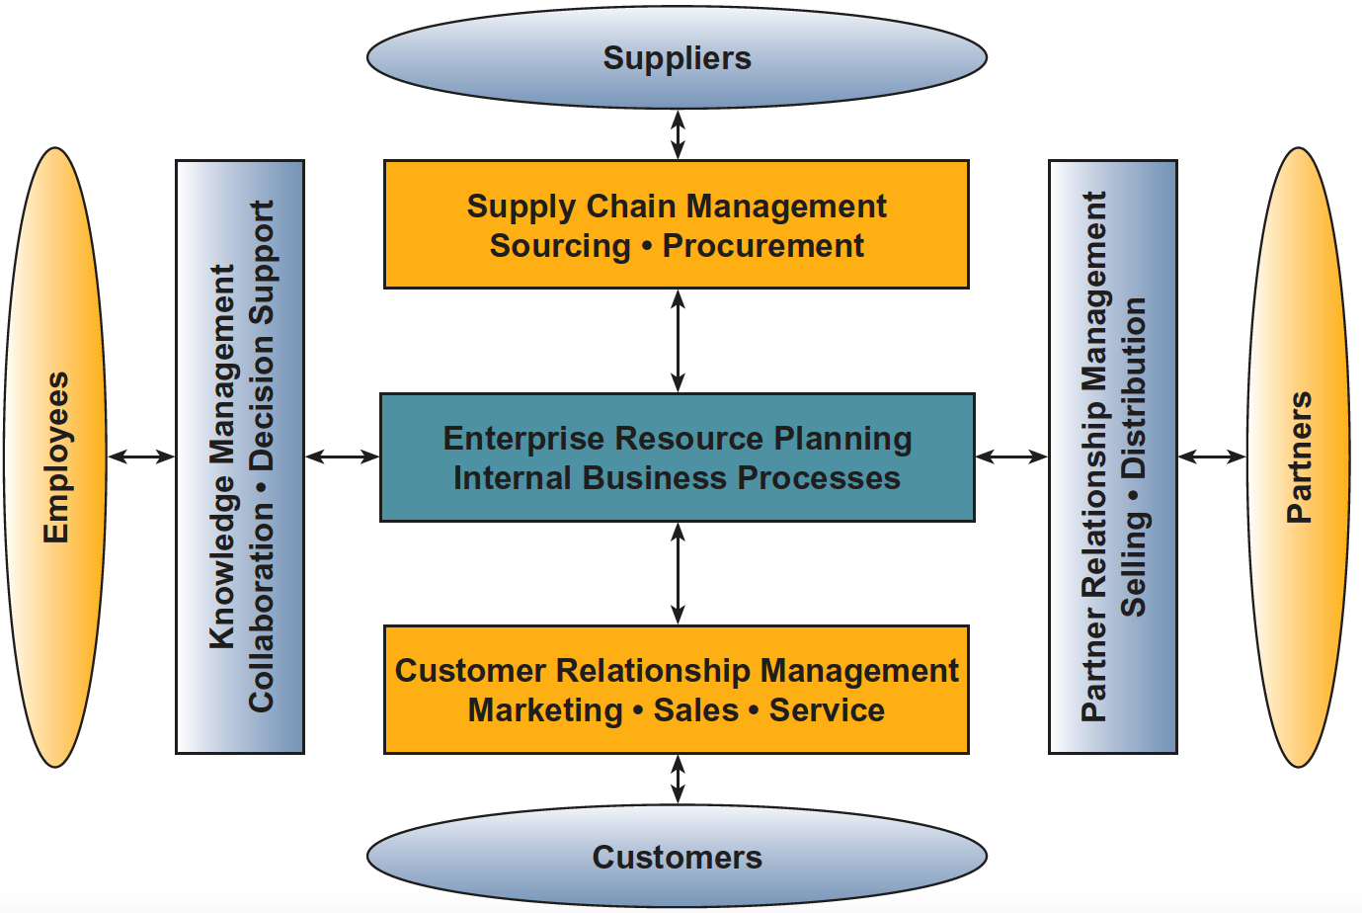
Enterprise application architecture

Slide 51
Enterprise resource planning (erp)
Backbone of the business!
Enterprise-wide transaction framework with links to other functional and cross functional systems
Integrates different systems by exchanging information
Provides real-time view of business operations

Slide 52
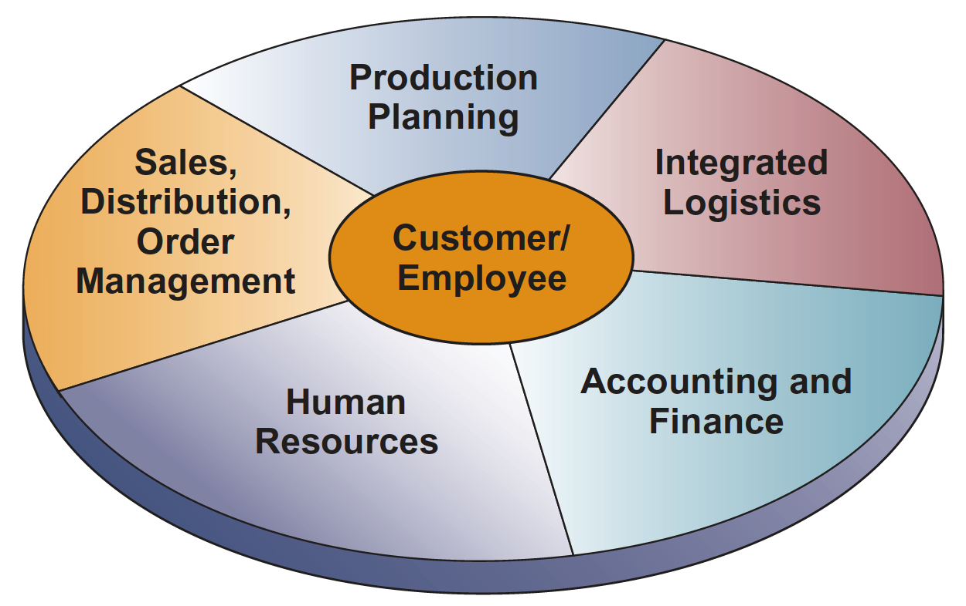
ERP - APPLICATION

Slide 53
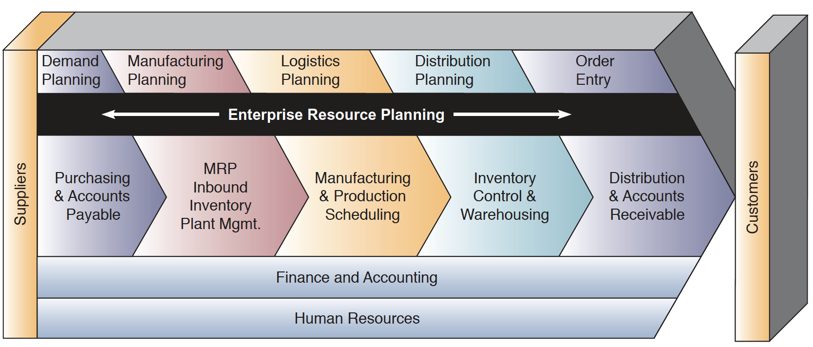
ERP – example (Colgate-palmlive co.)

Slide 54
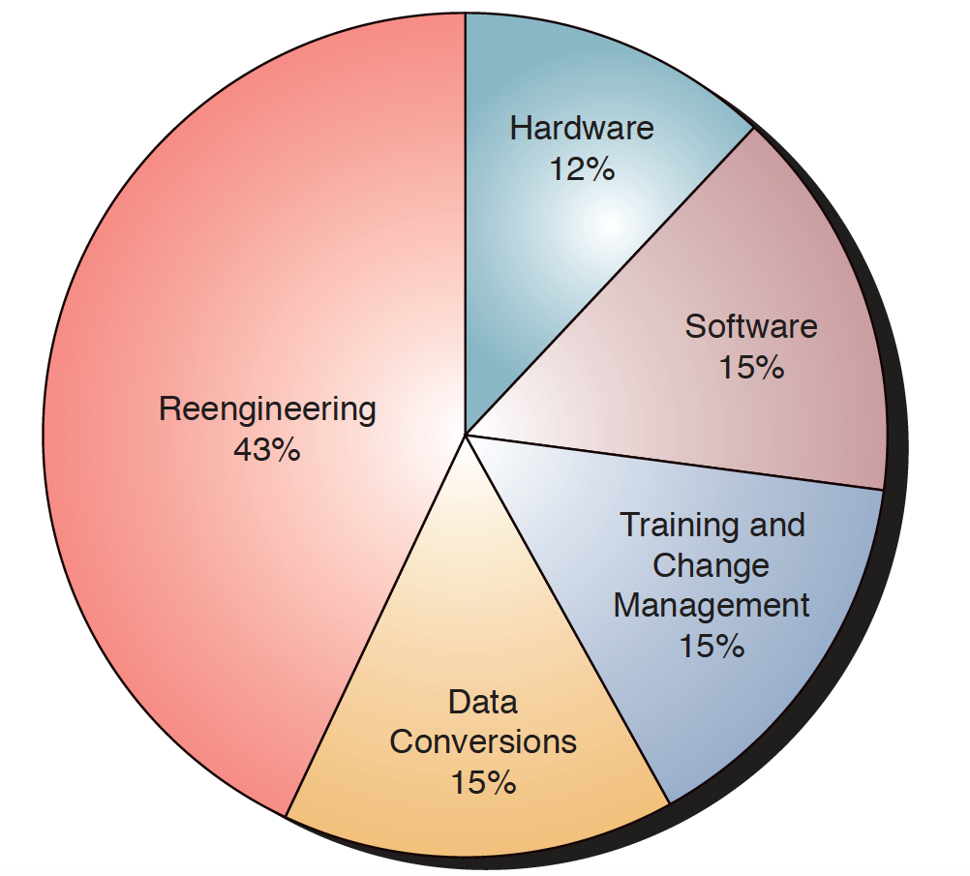
ERP – cost of implementation

Slide 55
ERP - Failures
Underestimation of complexity of ERP, lack of proper planning
Not complying with business process
Lack of employee training, resistance to chance
Over-reliance on claims of ERP vendor

Slide 56
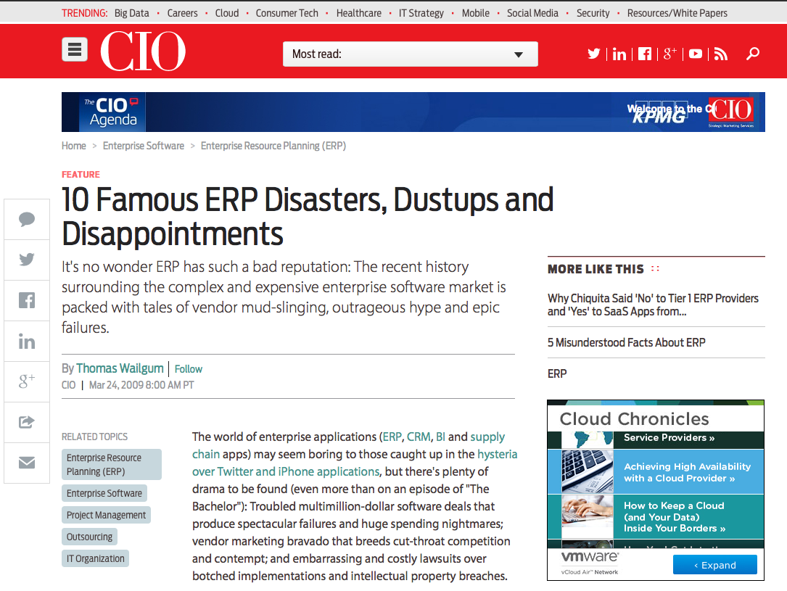
ERP - Failures
http://www.cio.com/article/2429865/enterprise-resource-planning/10-famous-erp-disasters--dustups-and-disappointments.html

Slide 57
ERP in Nepal
SAP in some corporates. NTC (SAP/R3), Ncell (SAP/R3), Surya Nepal (MySAP), Gorkha Brewary (SAP/R2), ...
Microsoft Dynamics
Tally ERP 9
Locally developed ERPs

Slide 58
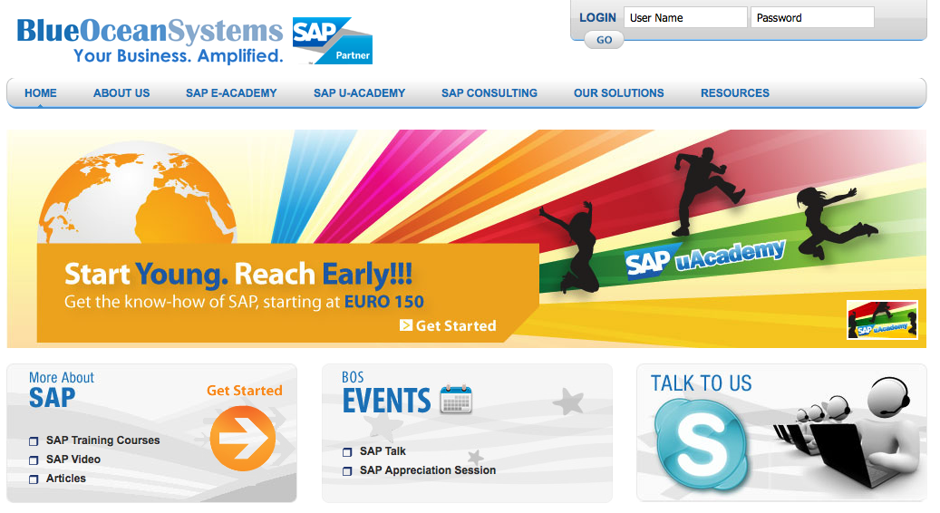
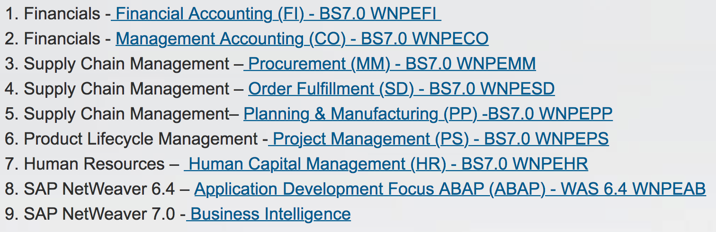
ERP – LEARNING & TRAINING

Slide 59
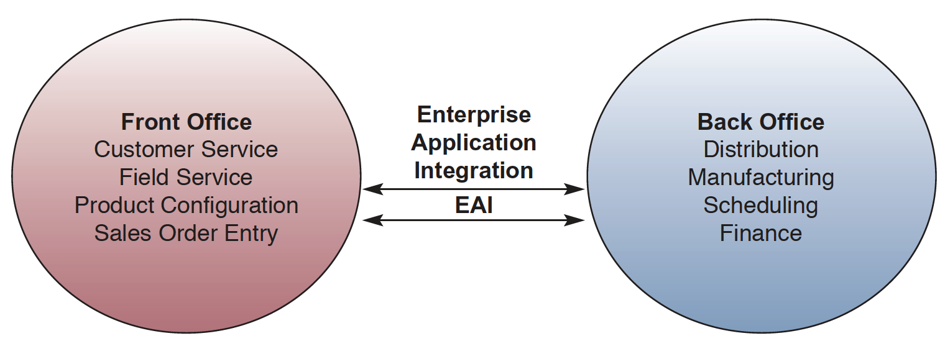
Enterprise application integration
EAI systems integrate different cross-functional systems by exchanging information among them.
Acts as a middleware performing - data conversion and coordination, application communication and messaging services, and access to the application interfaces involved.
Governed by rules of exchange

Slide 60
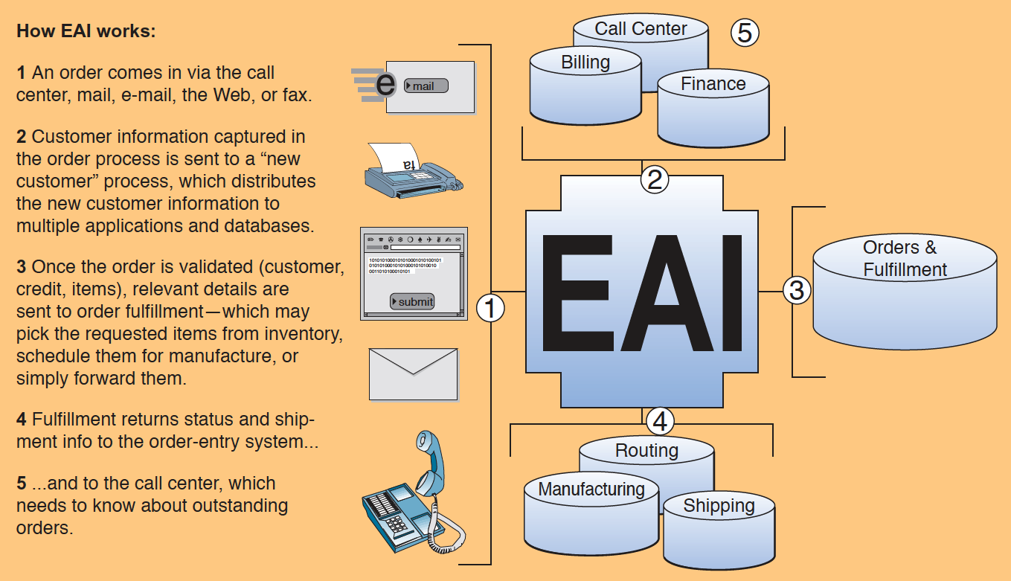
Enterprise application integration

Slide 61
Applications
60SCM, CRM, E-COMMERCE, DSS

Slide 62
SUPPLY CHAIN MANAGEMENT (scm) SYSTEMS

Slide 63
Supply chain management
Supply chain management (SCM) is the combination of art and science that goes into improving the way your company finds the raw components it needs to make a product or service and deliver it to customers.
Minimize inventory
Enable product visibility
Optimize transportation network

Slide 64
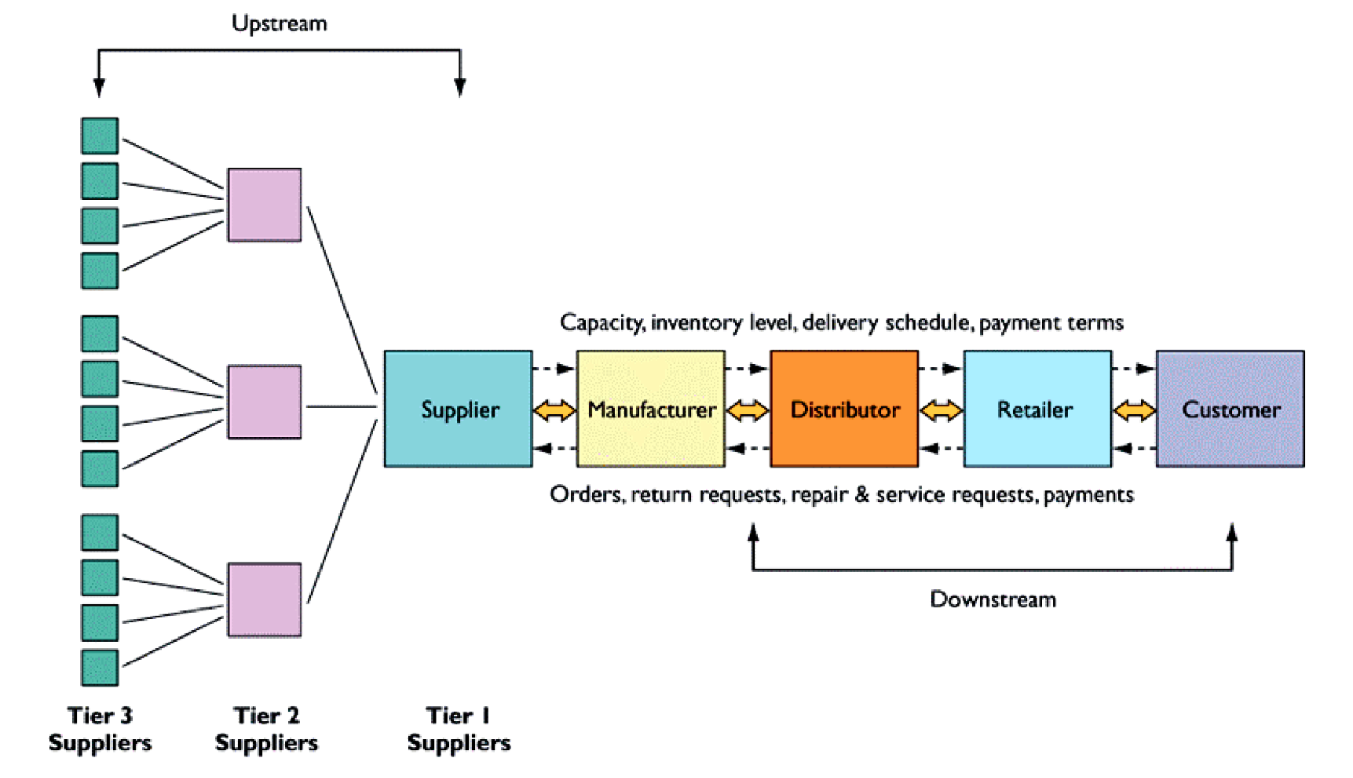
Supply chain management

Slide 65
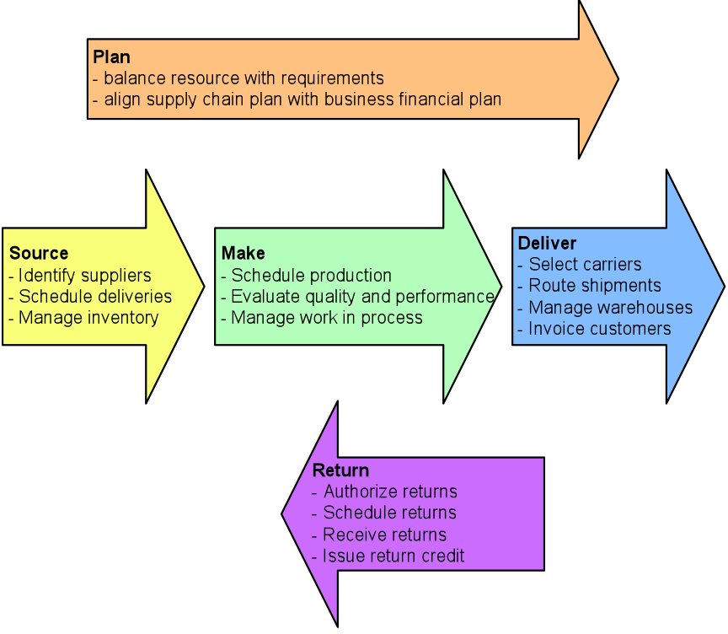
SCM - functions

Slide 66
SCM - functions
Plan – This is the strategic portion of SCM. You need a strategy for managing all the resources that go toward meeting customer demand for your product or service. A big piece of planning is developing a set of metrics to monitor the supply chain so that it is efficient, costs less and delivers high quality and value to customers.
Source – Choose the suppliers that will deliver the goods and services you need to create your product. Develop a set of pricing, delivery and payment processes with suppliers and create metrics for monitoring and improving the relationships. And put together processes for managing the inventory of goods and services you receive from suppliers, including receiving shipments, verifying them, transferring them to your manufacturing facilities and authorizing supplier payments.
Make – This is the manufacturing step. Schedule the activities necessary for production, testing, packaging and preparation for delivery. As the most metric-intensive portion of the supply chain, measure quality levels, production output and worker productivity.
Deliver – This is the part that many insiders refer to as logistics. Coordinate the receipt of orders from customers, develop a network of warehouses, pick carriers to get products to customers and set up an invoicing system to receive payments.
Return – The problem part of the supply chain. Create a network for receiving defective and excess products back from customers and supporting customers who have problems with delivered products.

Slide 67
DELL - Supply chain management
Dell online
Cost leadership
Collaborative commerce
Demand shaping

Slide 68
McDonald’s
Supply chain management

Slide 69
UPS and Toshiba
In-sourcing

Slide 70
Sony
Battery problem
Return

Slide 71
Supply chain management software
Each of the five major supply chain steps previously outlined composes dozens of specific tasks, many of which have their own specific software.
Need to track demand, supply, manufacturing status, logistics (i.e. where things are in the supply chain), and distribution
Share data with supply chain partners at an ever increasing rate
SAP’s Advanced Planner and Optimizer (APO) can perform many or all of these tasks

Slide 72
SCM – bullwhip effect
A supply chain might get affected by bullwhip effect in which information about the demand for a product gets distorted as it passes from one entity to the next across the supply chain
Bullwhip effect can be tamed by reducing uncertainties about demand and supply when all members of the supply chain have accurate and up-to-date information. They need to share information about inventory levels, schedules, forecasts, and shipments. This leads to have a more precise idea of how to adjust their sourcing, manufacturing, and distribution plans.

Slide 73
SCM systems/applications
Primary objective of supply chain management systems is information visibility – open and rapid communication and information sharing.
Helps the firms to manage its relationship with suppliers to optimize the planning, sourcing, manufacturing, and delivery of products and services.
Decide when and what to produce, store, and move
Rapidly communicate orders
Track status of orders
Check and monitor inventory
Reduce inventory, transportation, warehousing costs
Track shipments
Plan production based on actual customer demand
Rapidly communicate changes in product design

Slide 74
SCM systems/applications
Supply chain planning systems - enable the firm to generate demand forecasts for a product and to develop sourcing and manufacturing plans for that product.
Demand planning – one of the most important and complex supply chain planning function. It determines how much product a business needs to make to satisfy all of its customers’ demands.
Supply chain execution systems – manage the flow of products through distribution centers and warehouses to ensure that products are delivered to the right locations in the most efficient manner.

Slide 75
SCM systems/applications
Metric – standard measurement of performance
The fill rate – ability to fill orders by the due date
Average time from order to delivery
No. of days of supply chain in inventory
Forecast accuracy
The cycle time for sourcing and making a product (the total elapsed time to complete a business process)

Slide 76
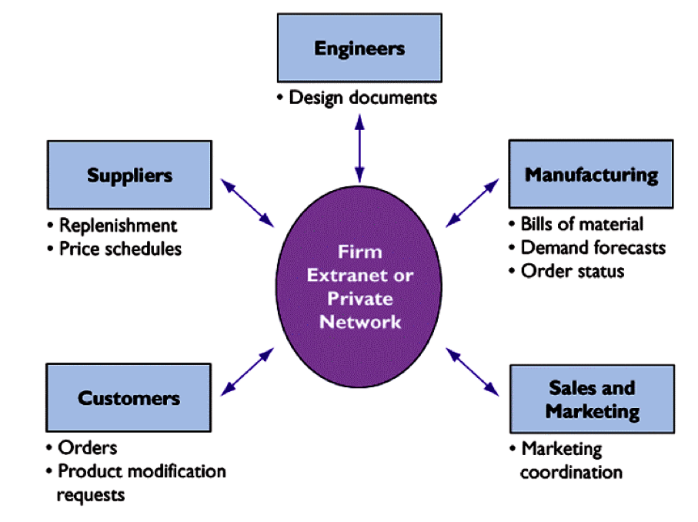
SCM – collaborative commerce
Uses digital technologies to enable multiple organizations to collaboratively design, develop, build, move, and manage products
Increases efficiencies in reducing product design life cycles, minimizing excess inventory, forecasting demand, and keeping partners and customers informed

Slide 77
Supply chain integration
For cost effective implementation, use Internet technology
Firms can use intranets to improve coordination among their internal supply chain processes, and use extranets to coordinate supply chain processes shared with their business partners.

Slide 78
Global supply chain issues
Greater geographic distance
Time difference
Outsourcing services

Slide 79
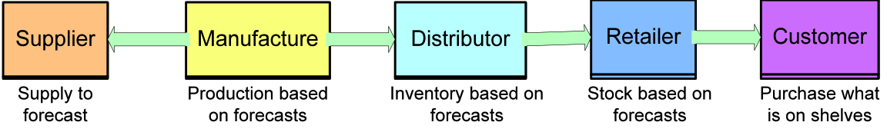
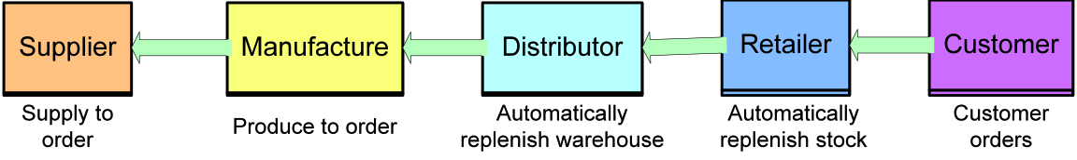
Demand driven supply chain
Earlier, supply chains were driven by push-based model - market forecasting triggers the events in supply chain
Due to web-based tools, pull-based model is possible
Also known as demand-driven model / build-to-order model
Customer triggers the events in supply chain

Slide 80
Business value of SCM systems
Improved customer service and responsiveness
Cost reduction
Cash utilization

Slide 81




Supply chain management
Technologies and tools
Just-in-time, Built-to-order
Material movement monitoring tools (RFID, barcode)

Slide 82
Case: Mediterranean shipping company
Business goal: cost leader, growth, transparency
Problem: Invisibility, port taxes
Solution: SCM Systems
Benefits:
Reduced costs
Visibility

Slide 83

Case: Fossil
Business goal: growth, customer satisfaction
Problem: incompatible systems
Solution: system integrator
Benefits:
Easier growth
Increased quality in customer service

Slide 84
CUSTOMER RELATIONSHIP MANAGEMENT (CRM) SYSTEMS

Slide 85
CRM Objectives
Traditional
Advertising model
One-to-many
Contemporary
Personalization model
One-to-one

Slide 86
CRM Objectives
Maintain customer life cycle
Identify good customers
Acquire
Enhance
Retain

Slide 87
CRM Objectives
Transition from ‘who sells most product’ to ‘who owns customers’?
Address different characteristics and expectations of the customers.
It takes 10 times more effort to get a new customer than keeping existing customers.
Manages ways used to deal with existing and potential customers

Slide 88
CRM Objectives
Both a business and technology discipline
Uses information systems to coordinate all customer interaction processes in sales, marketing, and service.
Habits and trends of customers.
Review customer history to identify the customer preferences. Maintain the inventory, receivable management, credit requirements.

Slide 89
Customer Responses
Direct mail: 29.2%
Telephone: 30.8%
Web: 16.0%
E-mail: 17.3%
SMS: 6.7%

Slide 90
CRM Systems
Pareto principle applies to CRM also - 80% of revenue from 20% of ‘good customers’
Now the problem is;
how to identify good customers?
How to keep them?
How to surprise them?
Track all customer interactions
Analyze data to optimize revenue, profitability, customer satisfaction, customer retention
Integrate the firm’s customer related processes

Slide 91
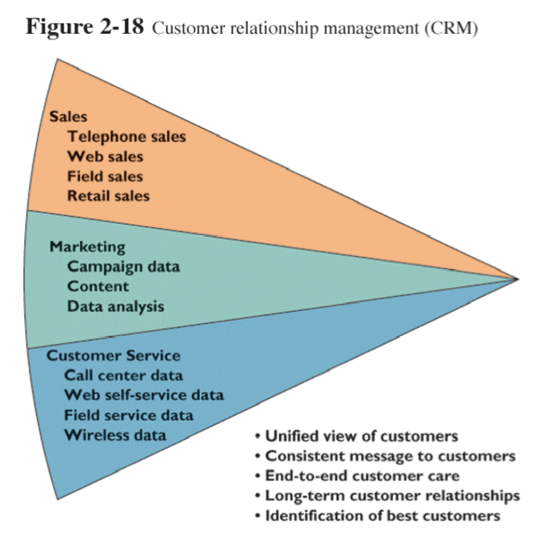
Functions of CRM Systems

Slide 92
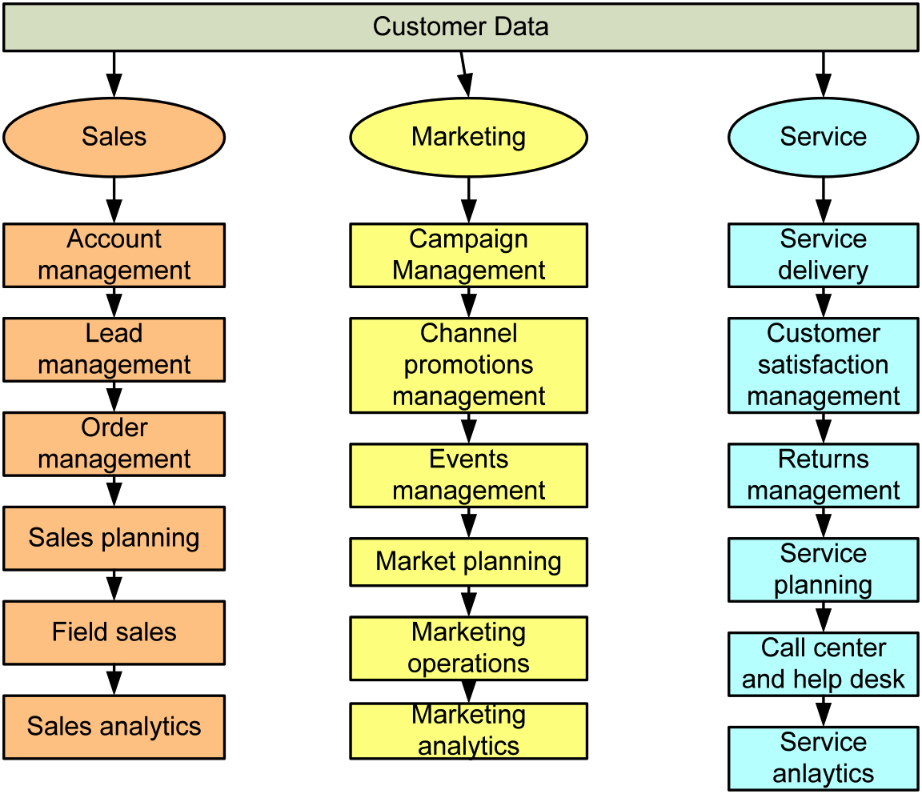
Capabilities of CRM Systems

Slide 93
Capabilities of CRM Systems
In overall, CRM systems capture and integrate customer data and disseminate the results to;
touch points – for enhanced customer service
managers – for better analysis of CRM

Slide 94
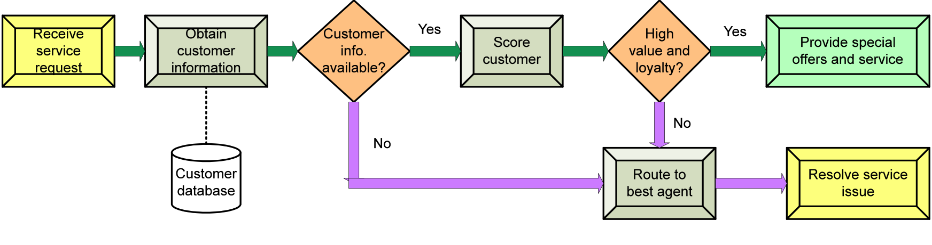
Customer Loyalty Management though CLTV
Customer Life Time Value

Slide 95
Components of CRM Systems
CRM Software
Business Processes
Users
Hardware and other support software
Alina Shrestha, MBA III, 2010, WhiteHouse GSM

Slide 96
Functional Modules of CRM Software
Direct marketing module - a set of promotional activities in which direct contact is made with the target customer allowing companies to identify target customers for particular promotional criteria, generate direct mails, analyze response from target customers.
CRM Sales Module - functions of pre-sales support, order placement, order scheduling shipping and invoicing and might be closely integrated with organizations‘ ecommerce websites.
Call Center Module
Help Desk Module - requests submission, email notification, searching Knowledge Base.
Alina Shrestha, MBA III, 2010, WhiteHouse GSM

Slide 97
CRM Technologies
Online CRM - CRM implemented in web-based platform
Hosted CRM - the CRM functions are hosted by a third party as an Application Service Provider. E.g. Salesforce.com
Mobile CRM – use three components (back end system, handheld device, and mobile middleware) to provide CRM functions on the move
Alina Shrestha, MBA III, 2010, WhiteHouse GSM

Slide 98
Operational and Analytical CRM
Operational CRM
Sales force automation (SFA)
Customer service and support (CSS)
Enterprise marketing automation (EMA)
Analytical CRM
Analysis
Association
Data mining

Slide 99
Operational CRM
Sales force automation (SFA) – floor planning, leads, forecasting, sales administration, tracking customer preference, performance management, accounting, contact management, and quota management
Customer service and support (CSS) – manage service requests, complaints, product return and enquiries
Enterprise marketing automation (EMA) – information regarding competitors, industries, macro-environmental variables etc.

Slide 100
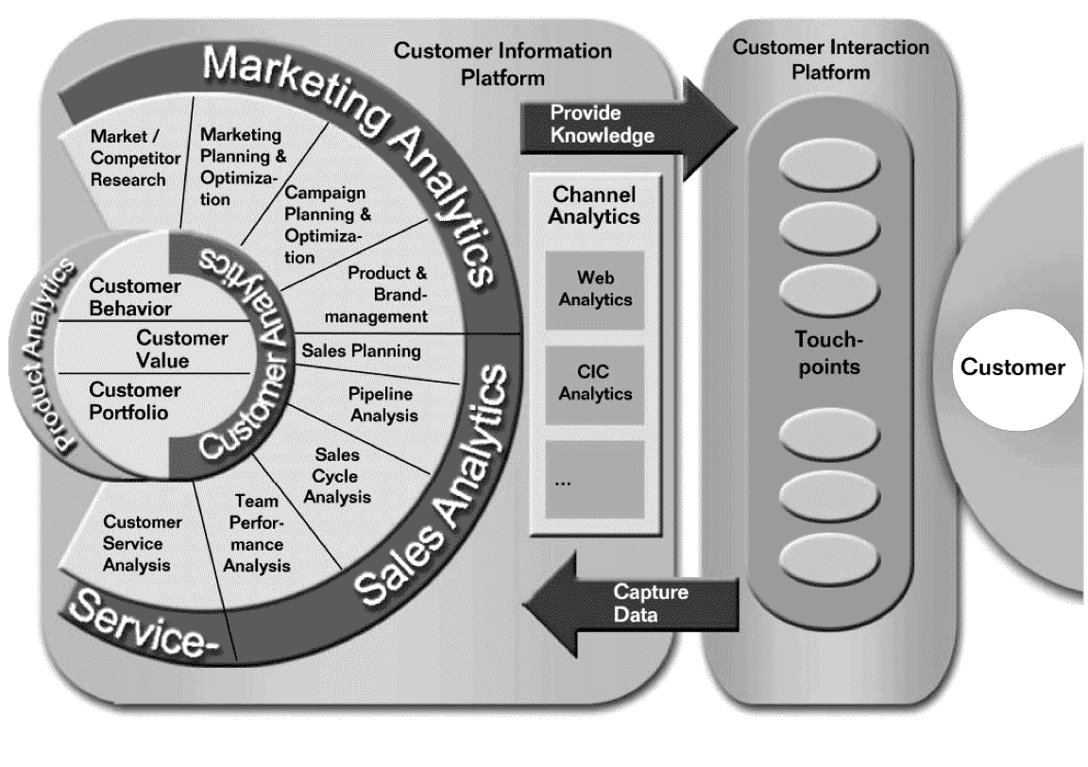
Business Architecture of Analytical CRM

Slide 101

Analytical CRM

Slide 102
Applications of CRM analysis
Product development
Program evaluation
Risk assessment and management
Strategic Marketing
Operational marketing
Contact optimization
Evaluating and improving customer satisfaction
Optimizing sales coverage
Fraud detection
Financial forecasts
Price optimization

Slide 103

Operational CRM and Analytical CRM

Slide 104
Collaborative CRM
Customer engagement
Employee relationship management
Partnership relationship management
Extensive use of technology for customer profiling and analysis

Slide 105
Business value of CRM Systems
Streamlined sales and marketing processes
Higher sales productivity
Added cross-selling and up-selling
Increased call center efficiency
Increased market share
Higher overall profitability
Marginal costing
Increased customer satisfaction
Reduced direct marketing costs
More effective marketing through better profiling and targeting (customer segmentation, analysis)
Lower costs for customer acquisition and retention
Increased sales revenue by identification of the most profitable customers and segments for focused marketing, cross-selling, and up-selling.
Reduced churn rates

Slide 106
Performance measure of CRM Systems
ROI
Cost per lead, cost per sale
No. of repeat customers
Reduction of churn rate
CLTV – cost of promotional marketing

Slide 107




CRM Systems – tools and software
Point of Sale (POS), Barcode scanner, RFID tags
Inventory management system, CRM software, e-Commerce website, Sales Intelligence, Market Basket Analysis, Association

Slide 108
DISCUSSION: WHAT VALUE AUTOMATED CHAT BOTS CAN PROVIDE TO CUSTOMERS ONLINE?

Slide 109
Internet-based business sector (e-Commerce)

Slide 110
Applications in Internet-based business sector (e-Commerce)
The Internet
Rapidly becoming infrastructure of choice
Universal, easy-to-use set of technologies and standards
Web sites available 24/7
Extended distribution channels
Reduced transaction costs
Reduced network and coordination costs

Slide 111
Applications in Internet-based business sector (e-Commerce)
New Business Models and Value Propositions
Past: Information about products and services bundled with their physical value chain
Today: The Internet has unbundled information from traditional value chain, creating new business models

Slide 112
Applications in Internet-based business sector (e-Commerce)
New Business Models and Value Propositions
Information Asymmetry - One party has more information essential to the transaction than the other party. The Internet shrinks information asymmetry.
Richness: depth and detail of information
Reach: how many people a business can connect with; how many products offered those people
Internet allows much richer communication with farther reach.

Slide 113
Applications in Internet-based business sector (e-Commerce)
Internet business models
Virtual storefront: Sells physical products directly to consumers or businesses.
Information broker: Provides product pricing and availability information; generates revenue from advertising or directing buyers to sellers.
Transaction Broker: Processes online sales transactions for fee.
Online Marketplace: Provides digital environment where buyers and sellers meet.

Slide 114
Applications in Internet-based business sector (e-Commerce)
Internet business models
Content Provider: Provides digital content, such as news; revenue from fees or advertising sales
Online Service Provider: Provides connectivity; revenue from fees, advertising, or marketing information
Virtual Community: Provides online meeting place for people of similar interests
Portal: Provides initial point of entry to the Web, along with specialized content and services
Syndicator: aggregates content or applications to resell as package to third-party Web sites

Slide 115
Applications in Internet-based business sector (e-Commerce)
Categories of e-Commerce
Business-to-consumer (B2C): Retailing products and services to individual shoppers. E.g. Amazon.com, thamel.com, muncha.com, recent acquisition of Daraz by Alibaba!
Business-to-business (B2B): Sales of goods and services among businesses. E.g. discussed later.
Consumer-to-consumer (C2C): Consumers selling directly to consumers. E.g. ebay.com, hamrobazaar.com, jobsnepal.com etc.

Slide 116

Applications in Internet-based business sector (e-Commerce)
Benefits of direct sales over the web
Disintermediation: Removal of intermediary steps in a value chain, selling directly to consumers, significantly lowers purchase transaction costs
Re-intermediation: Shifting intermediary function in a value chain to a new source, such as “service hubs”

Slide 117
Applications in Internet-based business sector (e-Commerce)
Benefits of customer-centered retailing
Interactive Marketing and Presentation
Collection of customer information using Web site auditing tools less expensive than surveys and focus groups
Web personalization technology customizes content on Web site to individual’s profile and purchase history
Web sites and marketing shorten sales cycle and reduce time spent in customer education

Slide 118
Applications in Internet-based business sector (e-Commerce)
Benefits of customer-centered retailing
Customer Self-Service
Web-based responses to customer questions cost a fraction of telephone costs for live customer service representation
Web-based customer self-service applications, such as airline flight information sites
Traditional, phone-based customer call centers being integrated with Web

Slide 119
Applications in Internet-based business sector (e-Commerce)
Internet reducing transaction costs
Transaction | Traditional | Internet
Checking bank account balance Answering a customer question Trading 100 shares of stock Correcting an employee record Processing an expense report Sending an advertising brochure Paying a bill | $1.08 $10-$45 $100 $128 $36, 22 days $0.75-$10 $2.22-$3.32 | $0.13 Answering an email query: $1 - $ 5 Web self-service: $0.1-$0.2 $9.95 $2.32 $4-$8, 72 hours $0-$0.25 $0.65-$1.1

Slide 120

Applications in Internet-based business sector (e-Commerce)
e-Commerce information flow

Slide 121
Applications in Internet-based business sector (e-Commerce)
Intranets
Intranets that provides various services like the Internet for an enterprise
Services;
Intranet portal, search
Media sharing
Departmental transactions
Communication and collaboration

Slide 122

Applications in Internet-based business sector (e-Commerce)
Intranets functional applications

Slide 123
decision support systems

Slide 124
Applications in decision support systems
DSS
Computer system at the management level of an organization
Combines data, analytical tools, and models
Supports semi-structured and unstructured decision making

Slide 125
Applications in decision support systems
MIS and DSS
MIS
Provides reports based on routine flow of data
Assists in general control of the organization
DSS
Emphasizes change, flexibility, rapid response, models, assumptions, ad-hoc queries, and display graphics

Slide 126
Applications in decision support systems
Types of DSS
Model-Driven DSS
Primarily stand-alone
Uses model to perform “what-if” and other kinds of analytical models from economics
Data-driven DSS
Supports decision making by allowing users to extract and analyze useful information previously buried in large databases

Slide 127
Applications in decision support systems
Data-mining technology used for DSS
To find hidden patterns and relationships in large databases to infer rules from them and predict future behavior
Associations: Occurrences linked to a single event
Sequences: Events linked over time
Classification: Recognizing patterns that describe the group to which an item belongs
Clustering: Similar to classification when no groups have yet been defined. Discovers different groupings within data

Slide 128

Applications in decision support systems
Architecture of DSS

Slide 129
Applications in decision support systems
Components of DSS
DSS Database: Collection of current or historical data from a number of applications or groups. Can be a small PC database or a massive data warehouse
DSS Software System: Collection of software tools used for data analysis, such as OLAP tools, data-mining tools, or a collections of mathematical and analytical models
Model: Abstract representation illustrating components or relationships of a phenomenon
Sensitivity Analysis: Models that ask “what-if” questions repeatedly to determine the impact of changes in one or more factors on the outcomes

Slide 130
Applications in decision support systems
Examples of Decision-Support Systems
General Accident Insurance: Customer buying patterns and fraud detection
Bank of America: Customer profiles
Frito-Lay, Inc.: Price, advertising, and promotion selection
Southern Railway: Train dispatching and routing
Texas Oil and Gas Corporation: Evaluation of potential drilling sites
The Gap: Inventory stocking and merchandising
United Airlines: Flight scheduling, passenger demand forecasting
U.S. Department of Defense: Defense contract analysis

Slide 131
Applications in decision support systems
DSS for Pricing Decisions
By analyzing several years of sales data for similar items, the software estimates a “seasonal demand curve” for each item and predicts how many units would sell each week at various prices.
The software uses sales history to predict how sensitive customer demand will be to price changes
DSS for Supply Chain Management
Can help firms model inventory stocking levels, production schedules, or transportation plans
Can provide firms with information on key performance indicators such as lead time, cycle time, inventory turns, or total supply chain costs

Slide 132

Applications in decision support systems
DSS for customer analysis and segmentation

Slide 133
Applications in decision support systems
Data Visualization and Geographic Information Systems (GIS)
Customer Decision-Support System (CDSS)
System to support the decision-making process of an existing or potential customer
Group Decision-Support System (GDSS)
An interactive computer-based system to facilitate the solution to unstructured problems by a set of decision makers working together as a group

Slide 134
Demo:
Data-driven model building for decision-making

Slide 135
Discussion on Nepali Business Scenario

